Slide 1




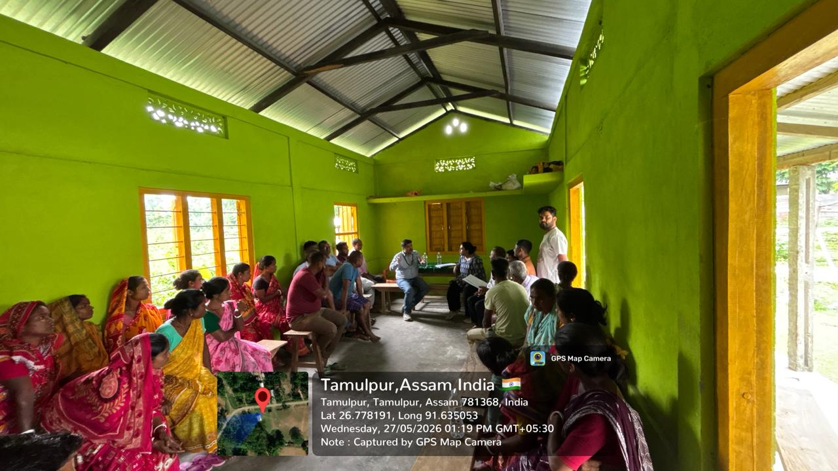
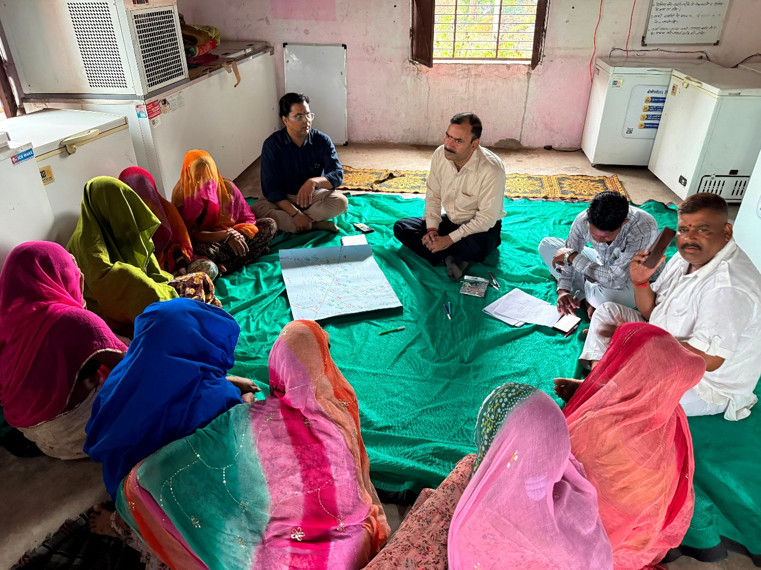
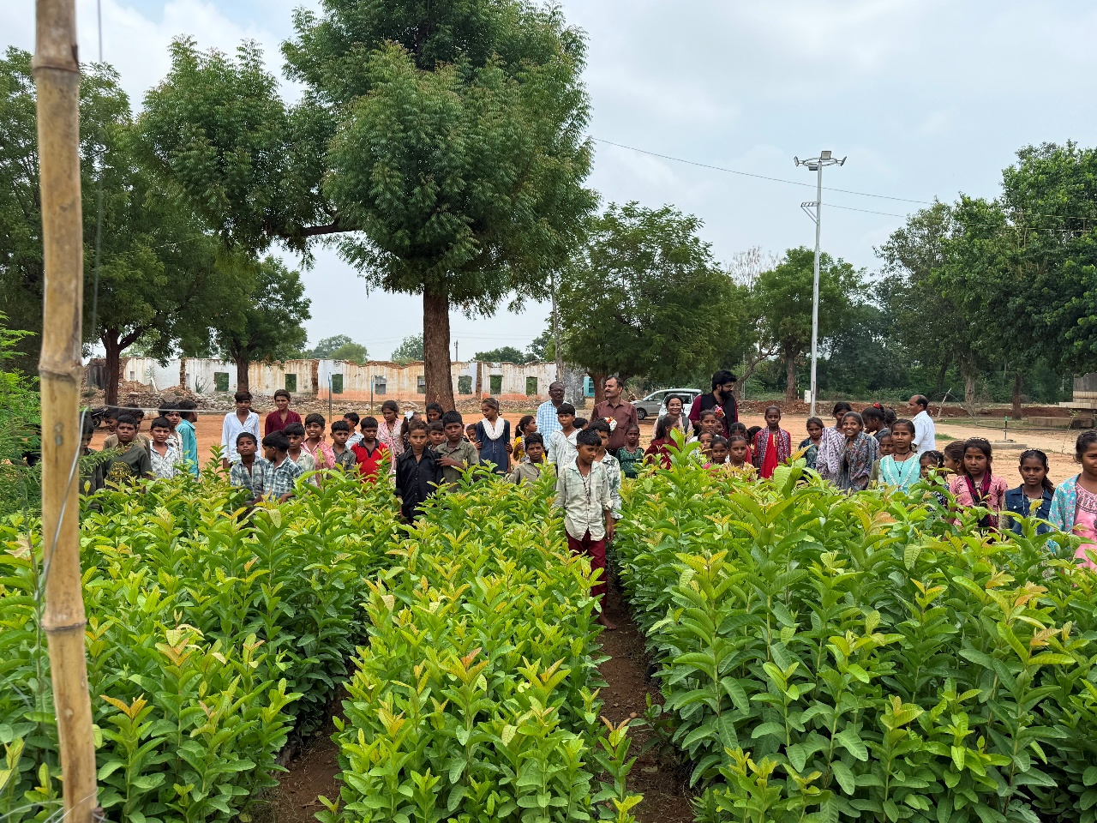
National Inception Workshop
GEF-Small Grants Programme (SGP) in India
Operational Phase – 8
31 July 2026, TERI, New Delhi

Slide 2

Overview of the SGP OP-8
Project Objective
SGP aims to empower local communities, CSOs, and CBOs
to deliver inclusive, innovative, and scalable solutions
to contribute to global environmental benefits in biodiversity conservation, climate change mitigation, land degradation neutrality, and chemical and waste management
to strengthen participatory landscape-seascape governance, institutional capacities, and community-driven knowledge systems.
GEF Trust Fund Co Financing | GEF Grant: USD 5.03 Million (INR 47.5 Cr) Co-finance: USD 5.30 Million (INR 50.3 Cr)
Thematic Areas | GEF focal area Land Degradation (LD) Biodiversity Conservation (BD) Climate Change (CC)
Project Period | 2024 - 2028

Slide 3
SGP OP-7 Learnings
SGP's Triple Role: Connecting Communities, Influencing Policy, and Enabling Markets
1. Community Connect (CSOs as First-Mile Partners): Leverages trusted local CSOs to mobilize communities and drive grassroots action.
2. Policy Leverage (From Evidence to Systems Change): Converts successful community pilots into scalable policy models aligned with national missions.
3. Market Linkages (Making Community Enterprise Viable): Connects community producers to value chains, finance, and market opportunities.

Slide 4
What’s New in OP-8
Landscape-seascape focus: Funding concentrated in priority landscapes
Five GEF focal areas: Biodiversity, Climate Change Mitigation, Land Degradation/Sustainable Land and Forest Management, Chemical and Waste Management
Bigger, needs-based grants: Higher ceilings, (Grant size: up to US $75,000 (INR 67,00,000)
More focus on convergence - Donor/government/ Private sector partnerships
Institutionalize SGP for sustainability beyond the project lifecycle

Slide 5
Progress of OP-8
1. Finalizing the country programme strategy and project results framework
2. Selecting landscapes through stakeholder consultations and defined selection criteria
3. Developing Annual Workplan and securing National Steering Committee approval for the plan and the selected landscapes
4. Holding multi-stakeholder meetings in each landscape-seascape to identify priority issues, sites, and potential solutions
5. Launching the first round of Requests for Proposals

Slide 6
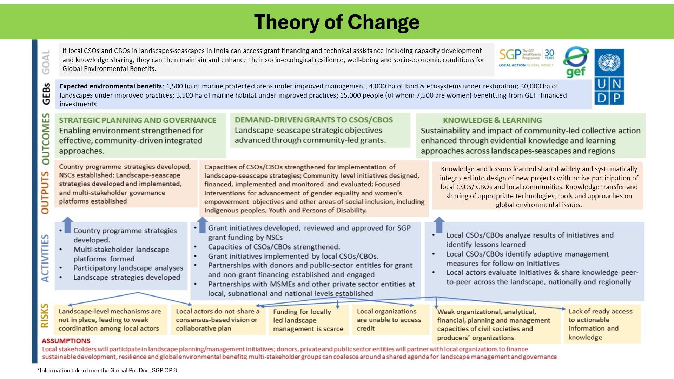

Slide 7
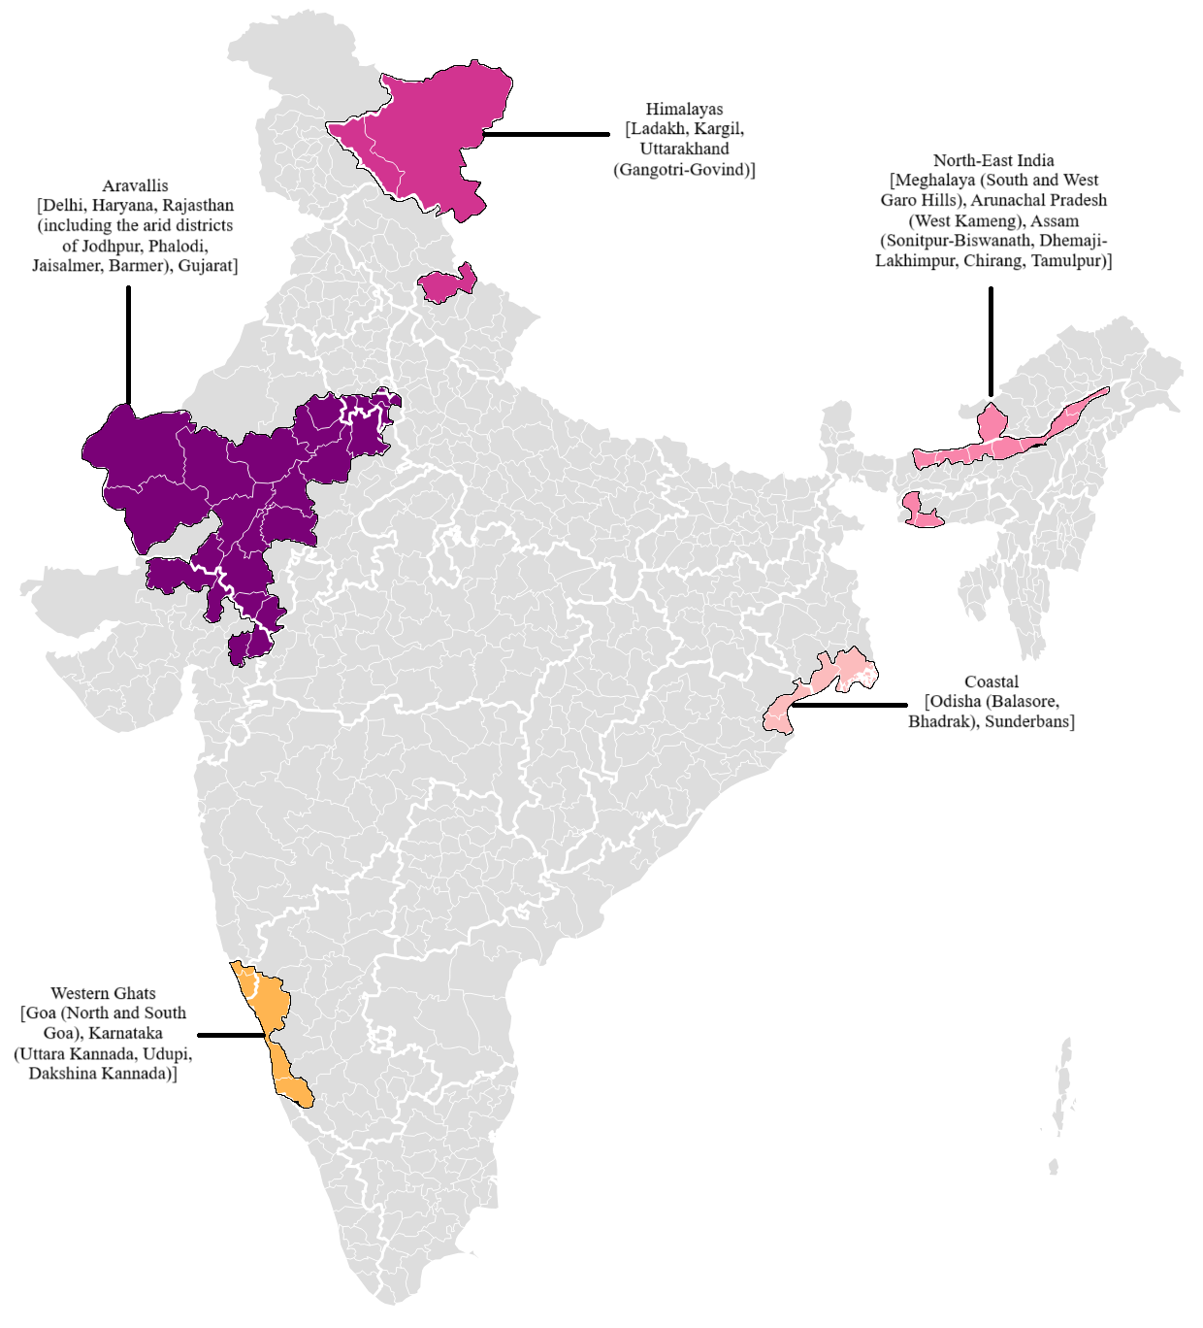
Project Landscapes
Aravallis - Delhi; Haryana, Rajasthan (including the arid districts of Jodhpur, Phalodi, Jaisalmer, and Barmer), Gujarat
Western Ghats - Goa (North and South Goa), Karnataka (Uttara Kannada, Udupi, Dakshina Kannada)
Coastal - Odisha (Balasore, Bhadrak), Sunderbans (South 24 Parganas)
North-East India - Meghalaya (South Garo Hills and West Garo Hills), Arunachal Pradesh (West Kameng), Assam (Sonitpur-Biswanath, Dhemaji-Lakhimpur, Chirang, Tamulpur)
Himalayas - Ladakh, Kargil, Uttarakhand (Gangotri-Govind)
*Information taken from the Country Programme Strategy of SGP India, OP 8

Slide 8
Overview of the Landscape Strategies
Understanding the Landscape
Building a baseline profile of the landscape
Stakeholder and Community Engagement following the COMDEKS approach for SEPLS
Consulting communities, landowners, government bodies, and technical experts shaping priorities and building legitimacy
Identifying the Challenges
Analyzing the pressures and potential of the landscape
Investing in Community Priorities
Ensuring Inclusion and Ownership
Defining the Strategic Response
Translating findings into a strategic framework
Identification of actions for on-the-ground investments
Embedding equity and local leadership
Connecting Action to Impact
Linking implementation to results

Slide 9
Major Stakeholders
Stakeholder Engagement
Small Grants Programme
Nodal Ministry
MoEFCC
District and local administrations
Central and State Governments and schemes
Universities and other educational institutions
Private Sector, Chambers of commerce and industry
SHGs, Forest Protection Committees, Federations, Cooperatives, Fishermen’s Associations, Youth Groups Etc
Inclusive governance: Involve representatives from diverse social groups in project planning and governance.
Public-private sector dialogue: Facilitate government–private sector engagement through structured dialogues.
Documented partnerships: Build and document partnerships advancing sustainable agriculture, fisheries, and/or food security.
Community participation: Engage local communities in identifying, developing, and adopting project initiatives.
Equity and inclusion: Ensure stakeholders commit to gender equality, women's empowerment, and youth/marginalized group inclusion.
Policy advocacy: Engage key stakeholders and advance advocacy through submission of policy recommendations particularly related to land-based pollution.

Slide 10
5
SGP- OP 8 Targets Under Key Focal Areas
Land Degradation
4,000 ha
Land Restored
30,000 ha
Under Improved Practices
Biodiversity Conservation
1,500 ha
MPAs Under Improved Management
3,500 ha
Marine Habitats Improved
Climate Change
49,275 tCO2
Emission Reductions (tCO2eq avoided)
Through ecosystem restoration, agroforestry, and low-carbon community practices across all landscapes
Chemical & Waste Management
Reduced use of hazardous agro-chemicals in community farming and artisanal activities; safer waste handling practices introduced in North-East India and Coastal landscapes
North-East India, Coastal
Sustainable Urban Solutions
Urban and peri-urban green infrastructure, nature-based solutions for coastal resilience; community-led models piloted in Delhi, Goa, and Odisha
Aravallis (Delhi), Coastal (Odisha), Western Ghats (Goa)
Cross-Cutting: 15,000 direct beneficiaries (50% women) | Models replicable in 3-5 districts | Strengthened governance & policy dialogue | South-South exchanges

Slide 11
Timeline
Launch of RFP
31 July 2026
Online Orientation Meeting
7 August 2026, 12.00 – 1.00 pm
Last date for seeking Clarifications / Queries
10 August 2026
Last Date & Time for receiving Proposals
31 August 2026 upto 1800 hours
Regional Orientation Meetings
8 – 18 August 2026 (Dates to be finalized)
Proposal evaluation including reviews by RAC, TAG and NSC
15 Sept- 14 October
Launch of the 2nd round of Call for Proposals
1 Nov- 20 Nov
Proposal evaluation including reviews by RAC, TAG and NSC
20 Nov- 19 Dec

Slide 12


Slide 13

Relevance to Sustainable Development Goals (SDGs)
1. No Poverty
15. Life on Land
14. Life Below Water
13. Climate Action
5. Gender Equality
12. Responsible Consumption and Production
11. Sustainable Cities and Communities
7. Affordable and Clean Energy

Slide 14



Thank You

Slide 15
Strategic Priorities: Alignment with National Priorities
Strategic Priority | Alignment with National Priorities
1. Community-based Conservation of Threatened Ecosystems and Species | Convention on Biological Diversity (CBD), the Kunming-Montreal Global Biodiversity Framework, and national strategies such as the National Biodiversity Action Plan and State Biodiversity Strategies and Action Plans (SBSAPs)
2. Sustainable Agriculture and Fisheries, and Food Security | SDG 2 (Zero Hunger), SDG 13 (Climate Action), and India’s commitments under the UNFCCC and the Kunming-Montreal Global Biodiversity Framework.
3. Low-Carbon Energy Access Co-Benefits | Operationalize NDCs, contributes to SDG 7 (Affordable and Clean Energy), SDG 13 (Climate Action), and SDG 8 (Decent Work and Economic Growth), while delivering inclusive and transformative local impacts.
4. Local to Global Coalitions for Chemicals and Waste Management | SDG 12 (Responsible Consumption and Production), SDG 3 (Good Health and Well-being), and SDG 13 (Climate Action). The SGP will continue to act as a catalyst for locally rooted, globally relevant solutions in the management of chemicals and waste.
5. Catalyzing Sustainable Urban Solutions | These urban pilots will contribute to India’s broader commitments under SDGs 11 (Sustainable Cities and Communities), 13 (Climate Action), and 12 (Responsible Consumption and Production), while addressing pressing local needs and enhancing urban ecosystem resilience.

Slide 16
Project Components
Component | Description | Outcome
Project Component 1 | Strategic Planning and Multi-Stakeholder Governance | Outcome1.1 Enabling environment strengthened for effective community driven integrated approaches.
Project Component 2 | Demand-driven grants to CSOs/CBOs | Outcome 2.1. Landscape seascape strategic objectives advanced through community-led grants
Project Component 3 | Knowledge Management and Learning | Outcome 3.1 Sustainability and impact of community-led collective action enhanced through knowledge management and learning approaches across landscapes seascapes and regions.
Project Component 4 | Monitoring & Evaluation | Outcome 4.1. Scale, durability and impact of locally-led community action strengthened through monitoring, evaluation and evidence-based learning.
*Information taken from the Project Results Framework of SGP India, OP 8

Slide 17
SGP OP - 7 Learnings
Sound planning, effective monitoring and evaluation, capacity building, and expert knowledge have driven successful outcomes for sustainable livelihoods, biodiversity, and ecosystem function.
Combining land restoration, biodiversity conservation, and climate action with sustainable livelihoods - especially for women - creates mutually reinforcing benefits
Government endorsement is crucial when working with rural, tribal, and marginalized communities, to ensure alignment with existing government projects.
Delays in grant approval reduce time for implementation, impact monitoring, and follow-up with funders for subsequent funding.

