Slide 1




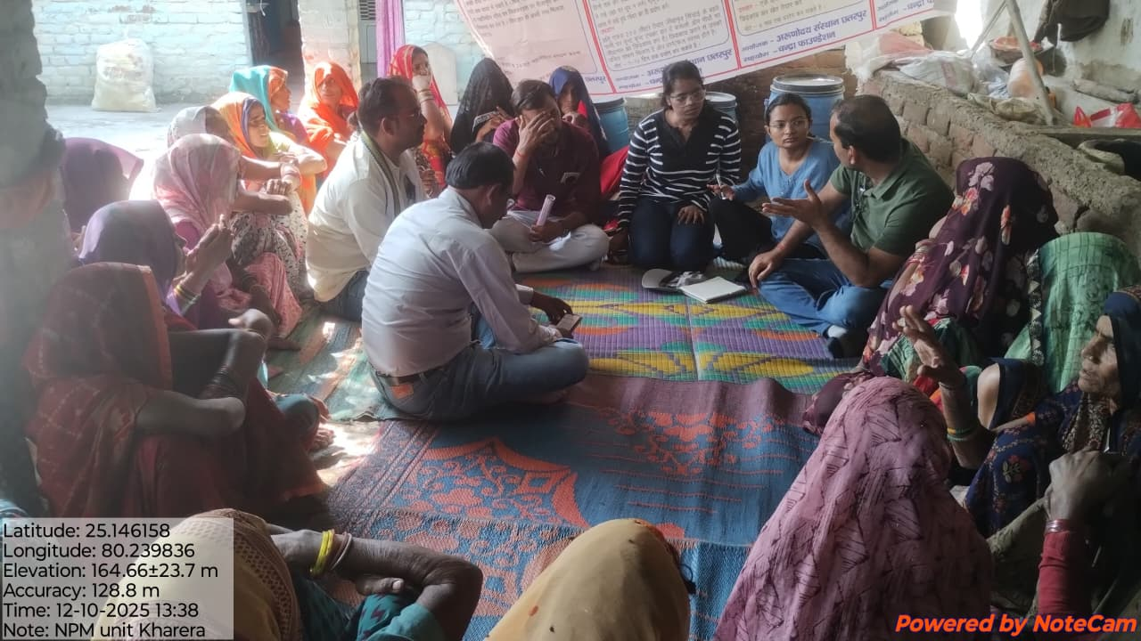
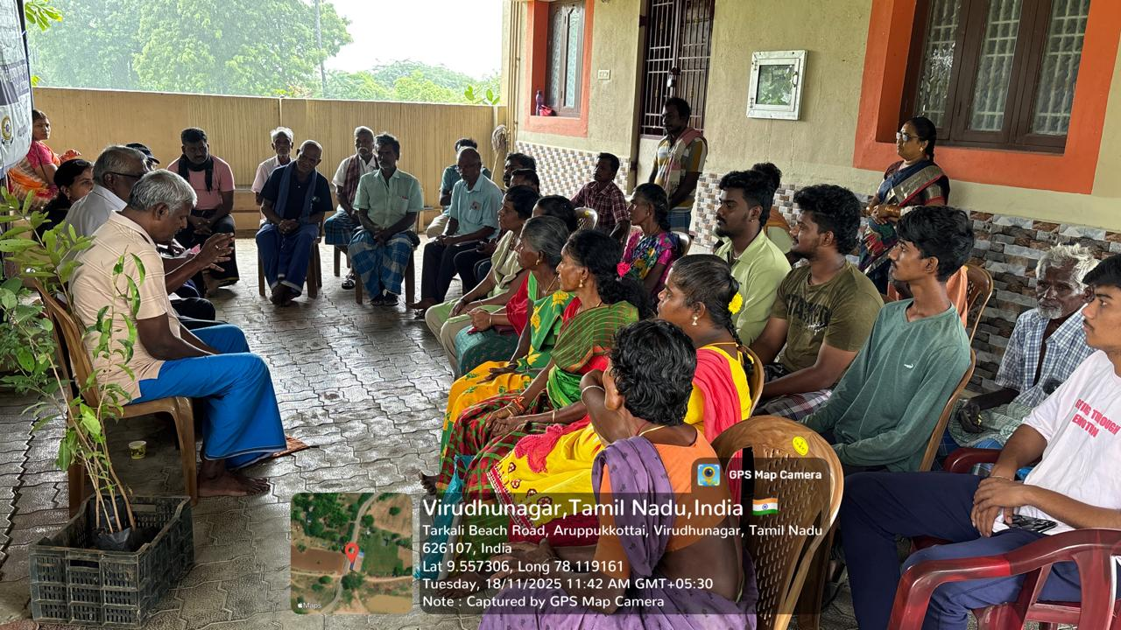
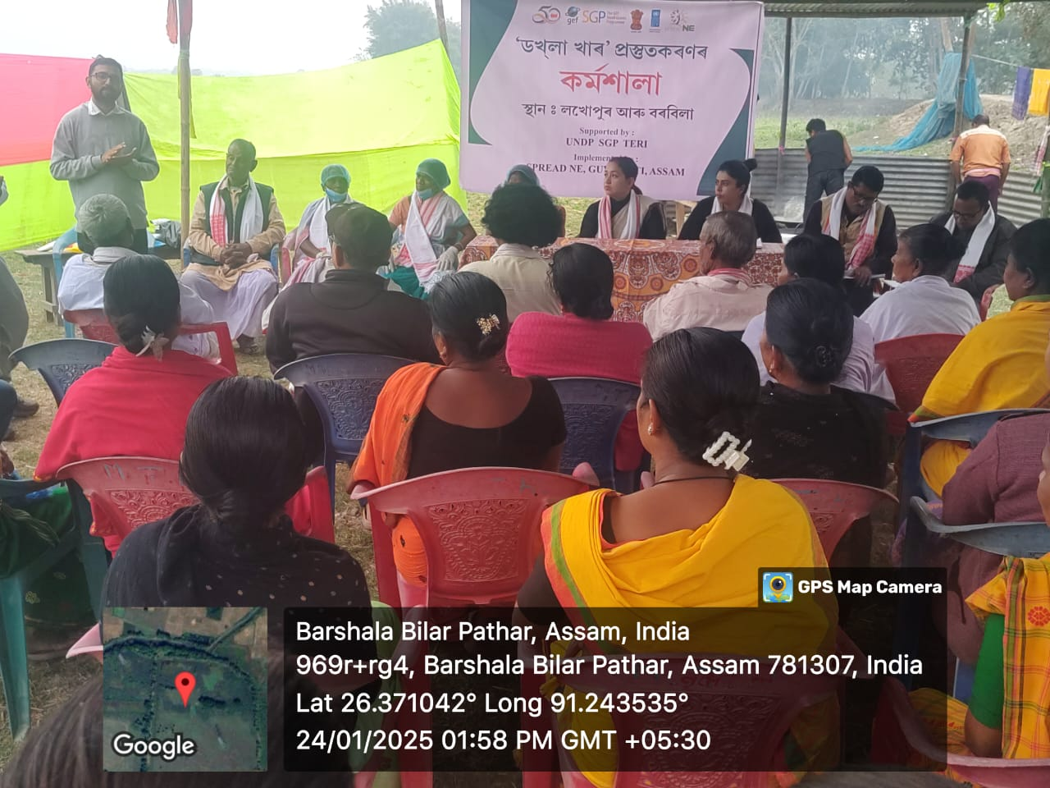
Small Grants Program (SGP) in India
Operational Phase 8

Slide 2
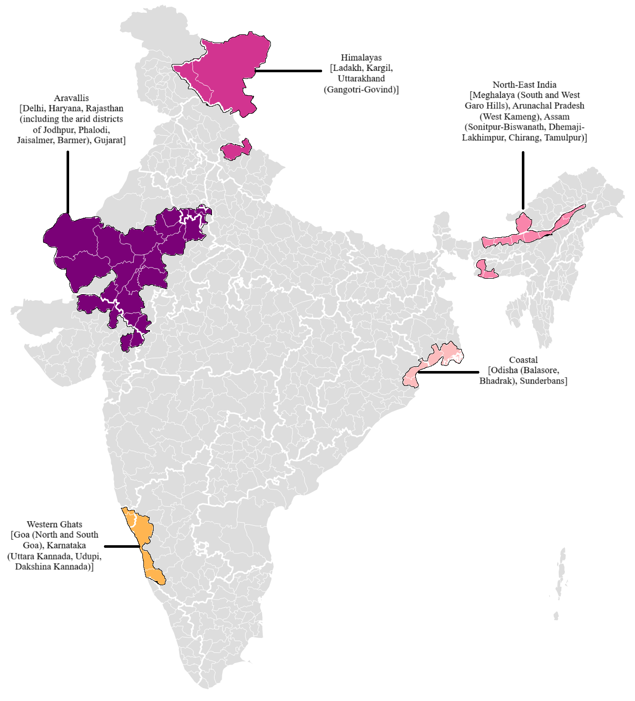

Overview of the Project
Objective | To enable communities and organisations to take collective action for socio-ecological resilience and sustainable livelihoods for local and global environmental benefits in three key landscapes of globally significant ecosystems in India.
Duration | 18-24 months
Grant | Up to 75000 USD
Thematic Areas | GEF focal area
 | Land Degradation (LD)
 | Biodiversity Conservation (BD)
 | Climate Change (CC)

Slide 3
5
Targets by GEF Focal Areas
Land Degradation
4,000 ha
Land Restored
30,000 ha
Under Improved Practices
Aravallis, Himalayas
Biodiversity Conservation
1,500 ha
MPAs Under Improved Management
3,500 ha
Marine Habitats Improved
Coastal, Western Ghats, North-East
Climate Change
49,275 tCO2
Emission Reductions (tCO2eq avoided)
Through ecosystem restoration, agroforestry, and low-carbon community practices across all landscapes
All 5 landscapes
Chemical & Waste Management
Reduced use of hazardous agro-chemicals in community farming and artisanal activities; safer waste handling practices introduced in North-East India and Coastal landscapes
North-East India, Coastal
Sustainable Urban Solutions
Urban and peri-urban green infrastructure, nature-based solutions for coastal resilience; community-led models piloted in Delhi, Goa, and Odisha
Aravallis (Delhi), Coastal (Odisha), Western Ghats (Goa)
Cross-Cutting: 15,000 direct beneficiaries (50% women) | Models replicable in 3-5 districts | Strengthened governance & policy dialogue | South-South exchanges

Slide 4
States and District coverage under OP-8
Region | State | District
Aravallis (30 Districts) | Rajasthan* | Ajmer, Alwar, Banswara, Bharatpur, Bhilwara, Chittorgarh, Dausa, Dungarpur, Jaipur, Jhunjhunu, Karauli, Nagaur, Pali, Pratapgarh, Rajsamand, Sawai Madhopur, Sikar, Sirohi, Udaipur
 | Gujarat | Banaskantha, Sabarkantha, Mehsana, Aravalli
 | Haryana | Bhiwani, Mahendragarh, Gurugram, Faridabad, Rewari, Charkhi Dadri
 | Delhi | South Delhi
Western Ghats (5 Districts) | Goa | North Goa, South Goa
 | Karnataka | Uttara Kannada, Udupi, Dakshina Kannada
Coastal (3 Districts) | Odisha | Balasore, Bhadrak
 | West Bengal | Sundarbans- South 24 Parganas
North-East (9 Districts) | Meghalaya | South Garo Hills, West Garo Hills
 | Assam | Sonitpur, Biswanath, Dhemaji, Lakhimpur, Chirang, Tamulpur
 | Arunachal Pradesh | West Kameng
Himalayas (2 districts) | Ladakh | Kargil
 | Uttarakhand | Gangotri, Govind

Slide 5
RFP on SGP India Website
SGP India Website
https://sgp-india.org/
https://sgp-india.org/apply-for-grants.php

Slide 6
ELIGIBILITY CRITERIA
Eligibility Criteria
Organisation should be registered trust / society in India for more than 5 years and registered with NITI Aayog's Darpan Portal.
REGISTRATION
.​
FINANCIAL CAPABILITY
Received an average turnover over 30 lakhs INR from project grants in the last three years
.
At least 3 projects in the field of environment, climate change, biodiversity conservation, and land degradation of minimum value 15 lakhs each, in the last 5 financial years. (for NER – 5 lakhs) and also in landscape.
TECHNICAL CAPACITY
.
SCALING CAPACITY
.
Ability to mobilise co-financing through parallel sources is expected
PROFESSIONAL CAPACITY
Organisation should have professionals with adequate experience in thematic areas and project management.

Slide 7
Evaluation Score Breakdown
Technical Scoring
80%
Financial Scoring
20%
Organizational experience in Focal Themes and Focus Landscape
40
Manpower Cost
5
Approach and Methodology
20
Co-financing
10
Advocacy Parameters
20
Miscellaneous
5

Slide 8
Co-Finance
SGP OP8 places strong emphasis on mobilising co-financing to enhance the scale, sustainability, and long-term impact of community-led initiatives.
All projects are expected to secure co-financing equivalent to at least a 1:1 ratio of the SGP grant, in the form of cash and/or in-kind contributions, as part of the total project budget.
Co-financing may be mobilised from government schemes, local bodies, private sector and CSR initiatives, financial institutions, development partners, community contributions, or implementing organisations.
In-kind contributions may include land, labour, equipment, technical expertise, volunteer time, or other resources that directly support project implementation.

Slide 9
Convergence and Partnerships
SGP OP8 will prioritize strategic convergence and partnerships with government, line departments, private sector organizations, research institutions, to maximize the impact, sustainability, and scalability of co
By aligning SGP interventions with central and state government programmes, urban development plans, and local governance priorities, the programme will leverage complementary resources, technical expertise, and policy support.
Collaboration with the academic & research institutes and private sector will facilitate innovation, access to technology, corporate social responsibility (CSR) investments, and market linkages for community enterprises.

Slide 10
Evaluation Steps
Eligibility Check
Technical Scoring
Financial Scoring
Review by Regional Advisory Committee (RAC)
Review by Technical Advisory Committee (TAG)
Approval by National Steering Committee (NSC)

Slide 11





Aravalli Priority Intervention Areas
Ecological Restoration & Biodiversity Conservation
Restore degraded forests, common lands & mining-affected areas; manage invasive species; conserve RET species and ecological corridors.
Water Security & Watershed Management
Revive traditional water bodies; build check dams, percolation tanks & recharge structures; promote efficient irrigation and watershed management.
Sustainable Agriculture, Agroforestry & Livelihoods
Promote climate-resilient farming, agroforestry & NTFP value chains; support decentralized nurseries, producer groups and enterprises.
Restoration of Mining & Industrially Degraded Land (Rajasthan)
Restore mining-affected land through native plantation and slope stabilization; promote green belts and industry-led environmental stewardship.
Strengthening Community Institutions & Governance
Build capacity of JFMCs/BMCs; prepare village conservation plans and include them in GPDP ; expand participation of women and youth; strengthen government convergence.

Slide 12
ICR Landscape Priorities and Strategic Interventions
WESTERN GHATS–COASTAL LANDSCAPE
Goa + Coastal Karnataka
Potential opportunities
Ridge-to-reef conservation
Restoration of wetlands, mangroves & estuaries
Sustainable fisheries & shellfish livelihoods
Biodiversity-based enterprises
Climate-resilient livelihoods
Priority Areas
Declining fisheries
Western Ghats–coastal connectivity
Kali, Sharavathi, Aghanashini & Gangavali river systems
Mandovi–Zuari estuaries & Khazan systems
Wetlands, mangroves & coastal habitats
Interventions
• River, wetland & mangrove restoration
• Sustainable fisheries & Fish FPOs
• Shellfish-based enterprises
• Climate-resilient agriculture & agroforestry
• Nature-based & women/youth enterprises
• Community conservation & BMCs
Potential opportunities
Ridge-to-reef conservation
Restoration of wetlands, mangroves & estuaries
Sustainable fisheries & shellfish livelihoods
Biodiversity-based enterprises
Climate-resilient livelihoods
Priority Areas
Declining fisheries
Pressure on natural resources
Changing agricultural systems
Livelihood vulnerability
Coastal development pressures
Interventions
Community-led restoration
Sustainable fisheries and shellfish systems
Biodiversity-compatible livelihoods
Strengthened local institutions
EAST COASTAL LANDSCAPE
Balasore + Bhadrak, Odisha
South 24 Parganas, West Bengal

Slide 13
Northeast Strategic Interventions
Climate Variability, and Limited Irrigation affecting Agriculture Productivity
Promote community-managed irrigation system, including solar-powered irrigation systems
Revival of traditional Dong system
Integrated farming, self-reliant farming, revival of traditional climate-smart crops (Millet)
Community-based pasture management, restoration of degraded grasslands
Agrobiodiversity, affecting food security
Revival of indigenous landraces, traditional seed conservation systems, homestead gardens, crop diversification, intercropping
Developing incentive mechanism, or nature-based enterprise
Responsible tourism
Value addition to local produces
Improved market access

Slide 14
Northeast Strategic Interventions
Human-wildlife conflict, particularly HEC
Strengthen community-based conflict management through early warning systems, village response teams
Promotion of alternative livelihood, cultivation of non-palatable crops
Community Outreach
Advocacy for crop insurance under PMFBY, other insurance schemes
Restoration of degraded habitats, revival of corridors
Recurring Flood, Wetland Degradation, Livelihood Vulnerabilities
Revival of traditional flood-resilient crops such as Bau-dhan (paddy)
Sustainable fisheries
Value addition
Improved market access
Promote nature-based solutions for flood management, restoration of riparian vegetation

Slide 15
Northeast Strategic Interventions
Solid Waste Management and Circular Economy Opportunities
Operationalise existing waste management infrastructure under Swachh Bharat Mission
Decentralise waste collection, household-level source segregation
Establish community-managed Material Recovery Facility (MRF)
Renewable Energy Access
Renewable energy-based livelihood intervention such as solar-powered rice mills, cold storage, post-harvest technologies
Decentralised renewable energy solutions such as solar-powered community infrastructure, solar home lighting systems

Slide 16



Ladakh (Kargil) Interventions
Agriculture & Climate
Hydrology
Clean Energy
Promote innovative water conservation measures, drip irrigation, cold-tolerant high-value crops, and solar greenhouse technology, native horticulture species.
Usage of check dams, and enhance community-led watershed management, afforestation.
Decentralised mechanisms for Rooftop Solar for space heating and lighting. Passive solar architecture.
Land & Urban Growth
Biodiversity Conservation
Waste & Pollution
Smart urban planning, regenerative agriculture, long-term soil health monitoring, and slope reforestation.
Species Conservation of Flora and Fauna (incl. Lichens), restoration of degraded habitats, HW Conflict mitigation strategies (incl. solar fencing, non-lethal methods).
Implement integrated solid waste management and ecotourism initiatives, awareness and outreach.
Notes:
These are the major issues identified but there may be more

Slide 17


Uttarakhand (Gangotri – Govindghat) Interventions
Soil Erosion & Slopes
Drying Natural Springs
Agriculture & Wildlife
Bio-engineering slope stabilisation, wall terracing, and native tree afforestation.
Springshed rejuvenation hydro-geological recharge trenches, and community water sanctuary protection.
Protection of wildlife habitat and agricultural lands, community solar fencing, non-palatable crops, and agro-forestry initiatives.
Energy & Waste
Gender & Livelihoods
Alternative fuels, improved cookstoves and RE access, waste management initiatives, awareness and outreach,
Empower Self-Help Groups (SHGs) in commercial value chains; promote ecotourism

Slide 18
Knowledge Management
The knowledge management objectives in SGP are to:
Capture knowledge,
Leverage local expertise and give voice to civil society,
Identify new approaches and ways of learning,
Improve effectiveness, improve capacities of staff and grantees,
Promote and encourage innovation,
Address operational and programmatic challenges effectively,
Influence policy and scale up good practices.
At the project level, each grant project needs to include a knowledge management plan with a corresponding budget
Focus should be to capture their experience as well as to access the training needed to carry out the projects
Knowledge management activities at the project level could include peer to peer learning, training and facilitated exchange of knowledge.

Slide 19
KM Activities
Case studies
Fact sheets
Articles
Video/photo-stories
Peer-to peer knowledge exchanges
Demonstration centers
Training workshops

Slide 20
What is Free Prior and Informed Consent?
FPIC is the right of Tribal Communities to make informed decisions about activities that may affect their lands, resources, livelihoods, culture, or traditional knowledge.
The Four Principles
🟢 Free – Participation is voluntary and free from coercion, pressure, or intimidation.
🟢 Prior – Consent is sought before any project activities begin.
🟢 Informed – Communities receive complete, accurate, and understandable information on the project, including its benefits, risks, and alternatives.
🟢 Consent – Communities have the opportunity to discuss, ask questions, and make their own decisions through their customary decision-making processes.

Slide 21
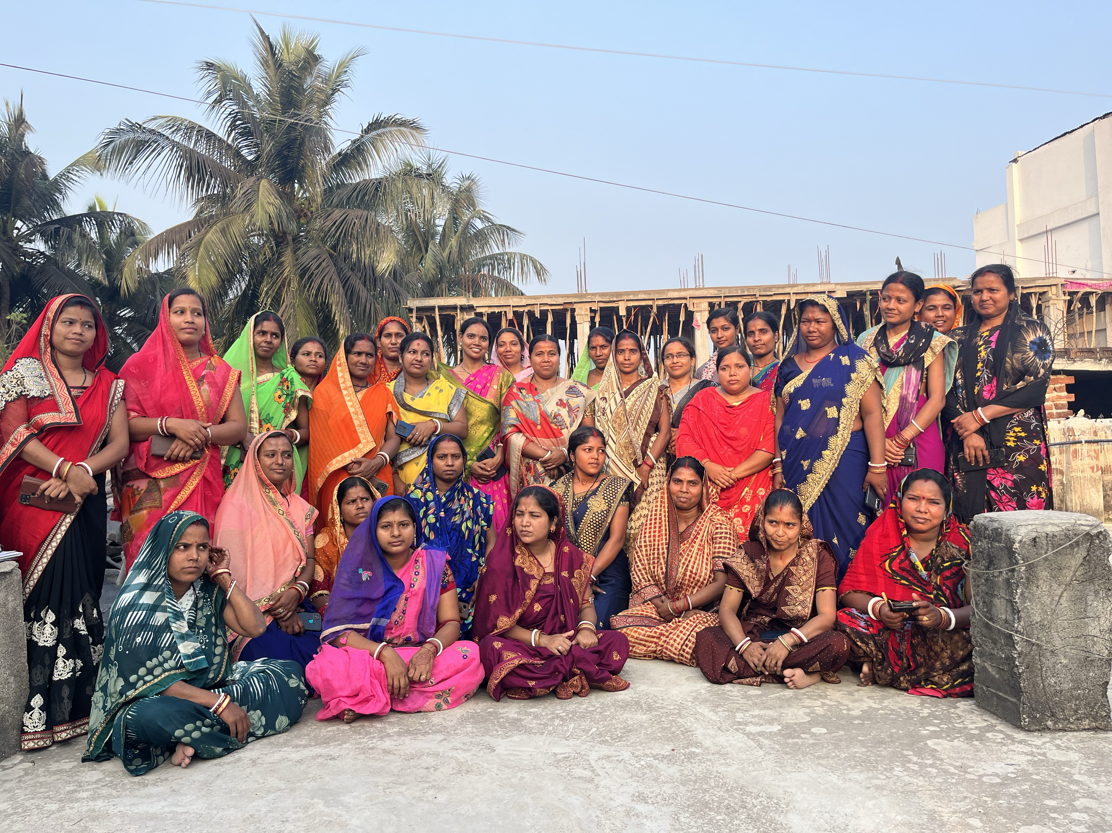
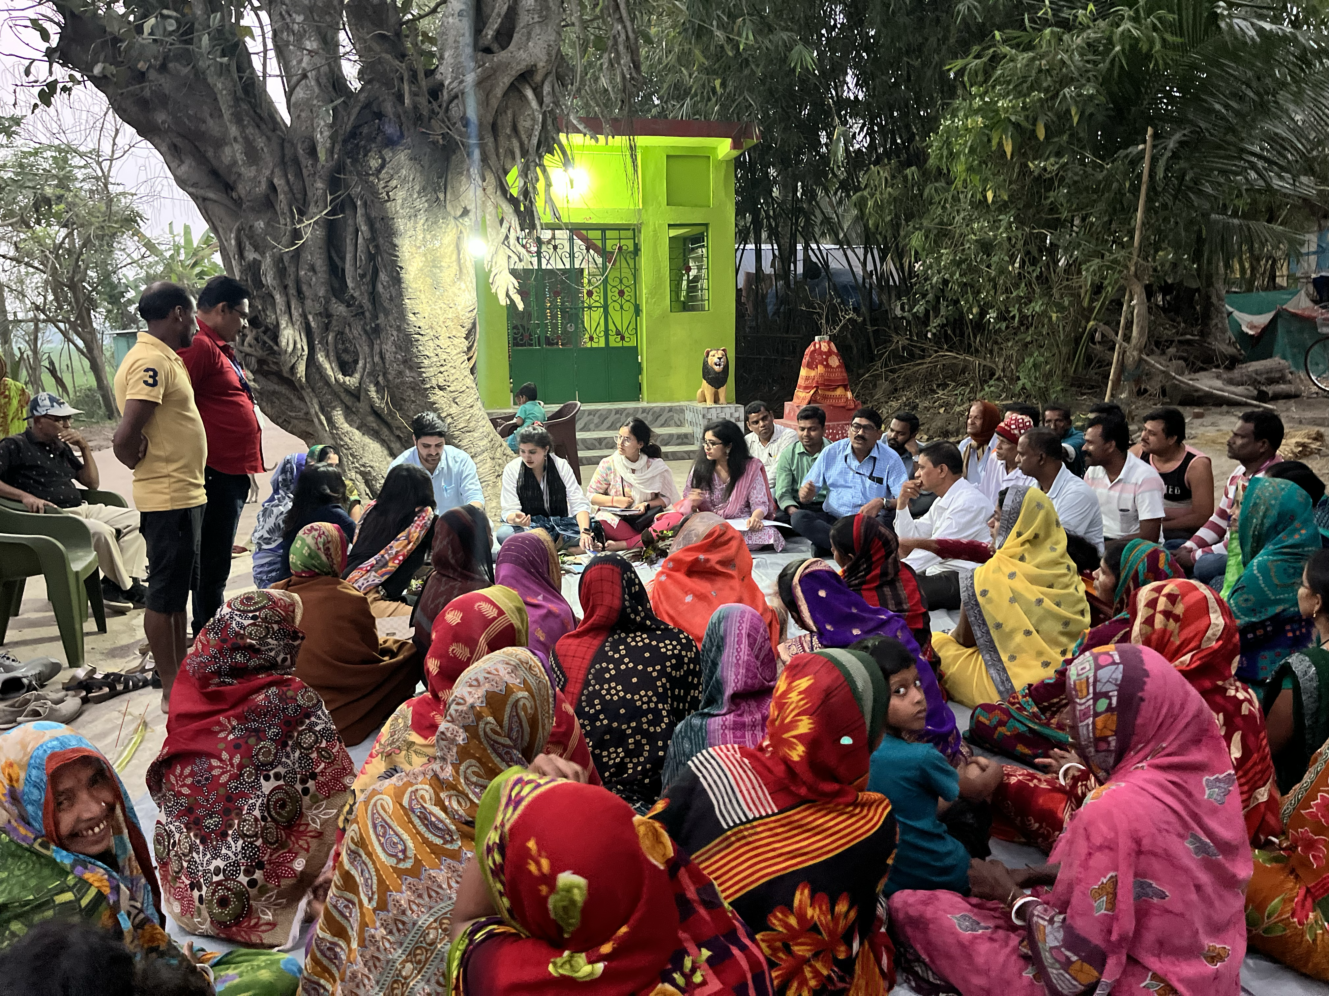
What are Social and Environmental Safeguards
Social and Environmental Safeguards (SES) are measures that help ensure projects:
Avoid harm to people and the environment.
Maximize positive social and environmental benefits.
Are inclusive, sustainable, and resilient over the long term.
Why are SES Important?
✅ Protect biodiversity and natural resources
✅ Ensure women, local communities, and vulnerable groups benefit
✅ Prevent unintended negative impacts on communities and ecosystems
✅ Improve project sustainability and long-term impact
✅ Ensure compliance with UNDP and GEF requirements

Slide 22
Integrating Social & Environmental Safeguards (SES) in your proposal
Think About… | What to Include in Your Proposal
👥 Inclusion & Equity | Who will benefit? How will women, tribal communities, youth, persons with disabilities, and other vulnerable groups participate and benefit?
🤝 Stakeholder Engagement | Have you consulted communities? How will you ensure meaningful participation throughout implementation? Is there a way for communities to raise concerns?
🌿 Biodiversity & Environment | Could your activities affect forests, wildlife, wetlands, rivers, mangroves, or other sensitive ecosystems? What measures will you take to avoid or minimise impacts?
🌦️ Climate & Disaster Risks | Could floods, droughts, heatwaves, landslides, cyclones, or other climate hazards affect your project? How will your activities remain resilient?
🏛️ Cultural Heritage | Will your project affect sacred sites, traditional knowledge, heritage structures, or culturally significant areas? How will these be protected?
🌏 Tribal Communities | If working with tribal communities, how will you ensure Free, Prior and Informed Consent (FPIC), meaningful participation, and respect for traditional rights and knowledge?
♻️ Pollution & Waste | Will the project use fertilizers, pesticides, plastics, or other materials? How will waste be safely managed? For Renewable energy projects- how will we ensure active waste management.

Slide 23


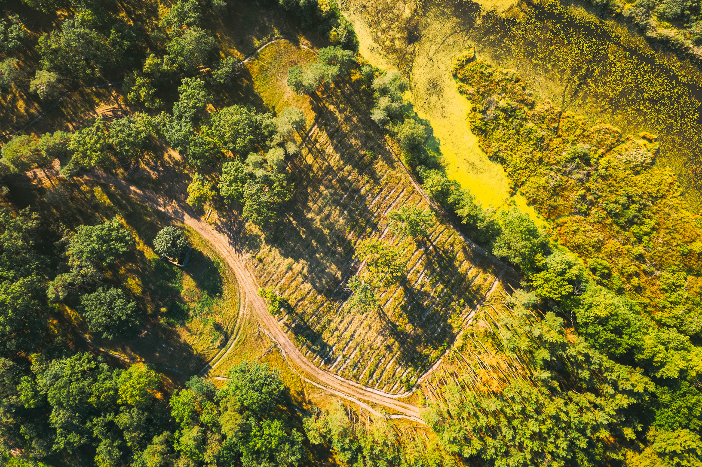
Thank You

