Slide 1






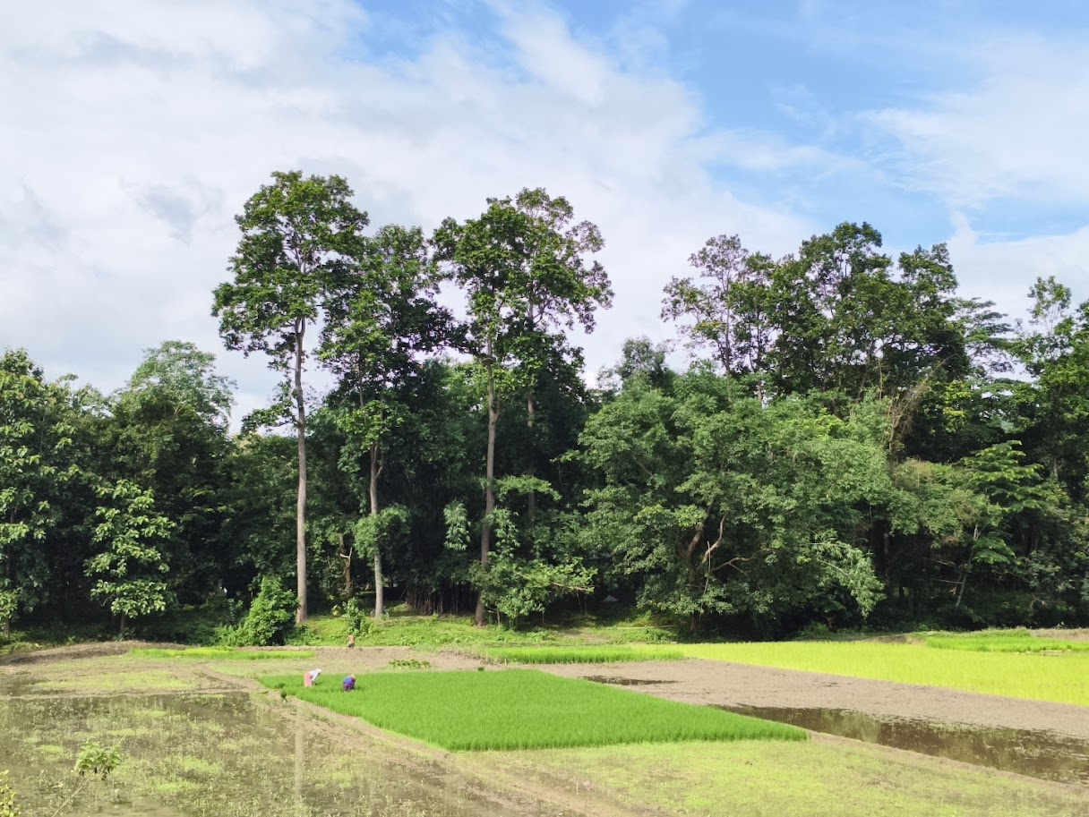
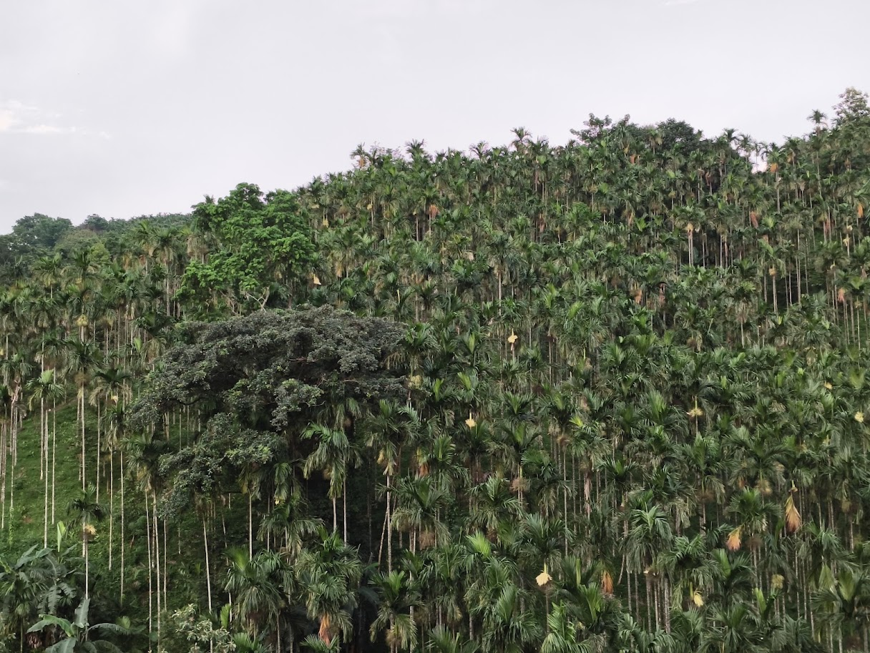
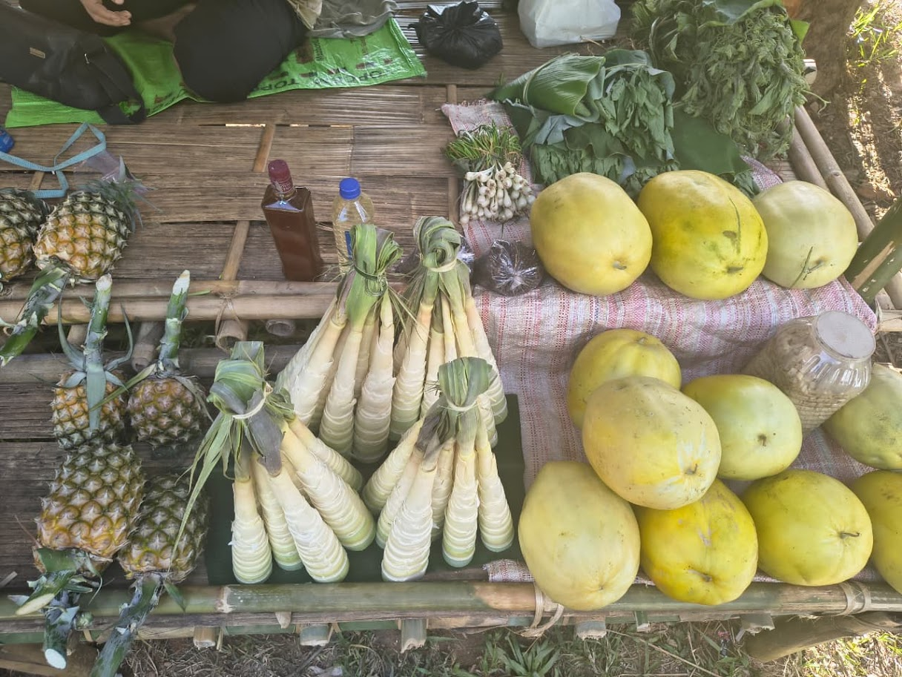
Landscape Strategy for Northeast Region under SGP OP8
Towards Building Social, Economic and Ecological Resilience Through Community-based Initiatives
Northeast Landscape- Assam, Meghalaya and Arunachal Pradesh
By Alolika Sinha and Sounika Karmakar

Slide 2

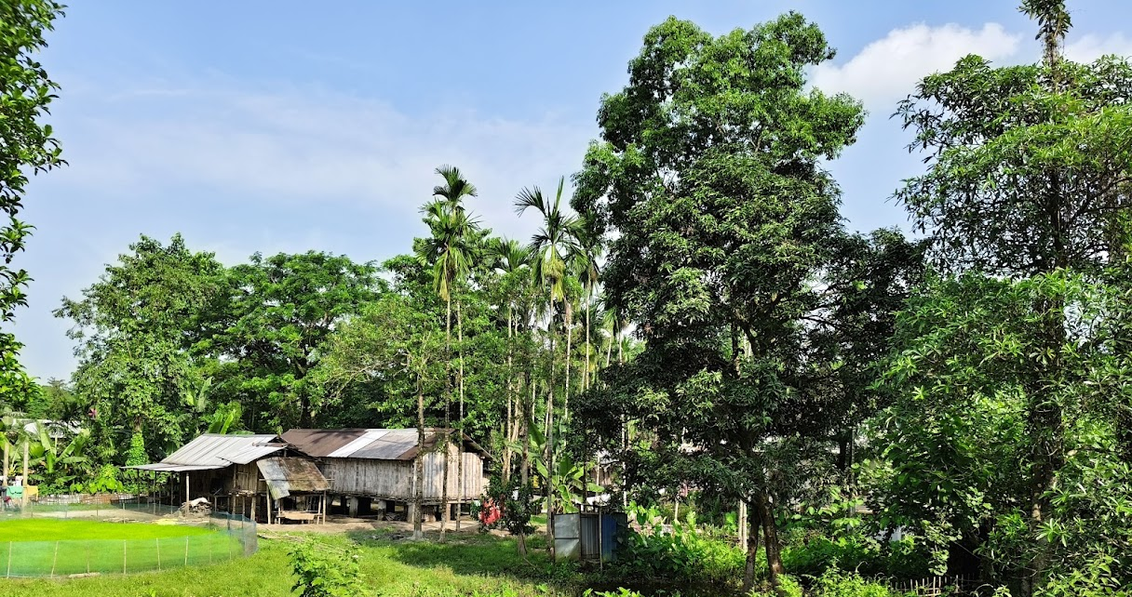
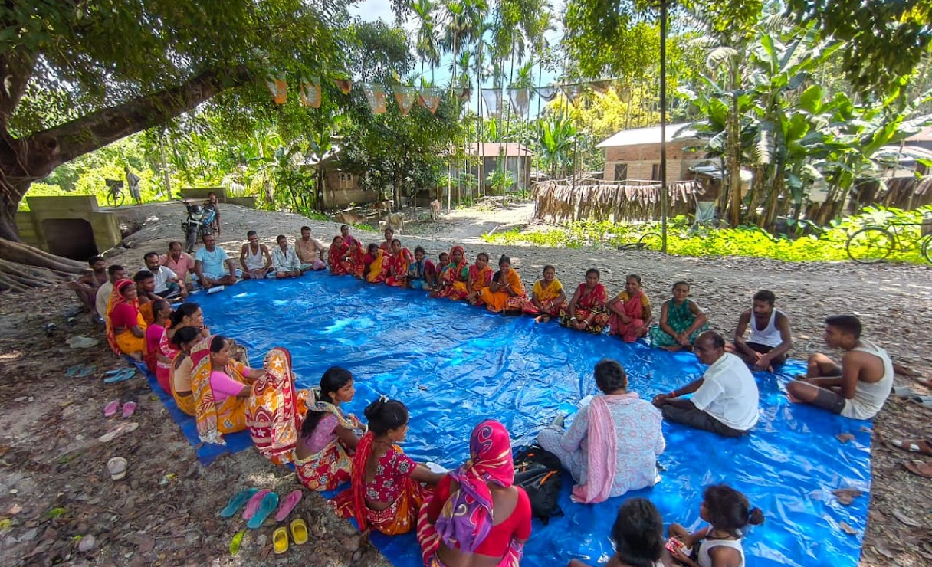
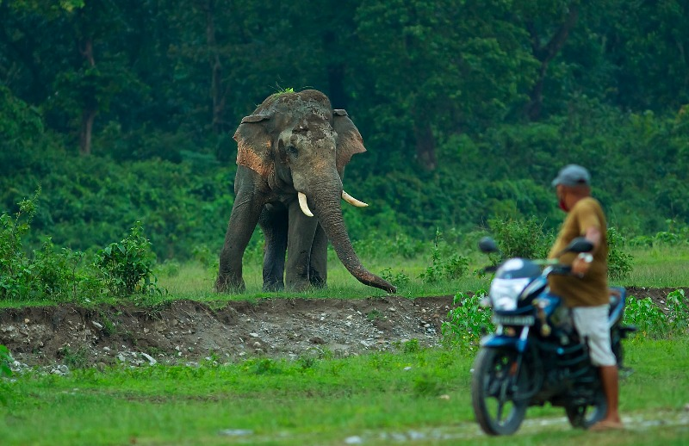


Overview
Priority Landscape
Why this landscape?
What are the characteristics?
Stakeholder Mapping
Who are the key stakeholders?
How will stakeholders be engaged?
Potential Convergences
Areas of collaboration and convergences- What are the existing schemes and program?
Situation Analysis
What are the key problems?
What are the opportunities?
Strategy to Impact
If community-based projects are supported, what we will achieve?
Strategic Responses
What are potential community-based projects that can be supported?

Slide 3
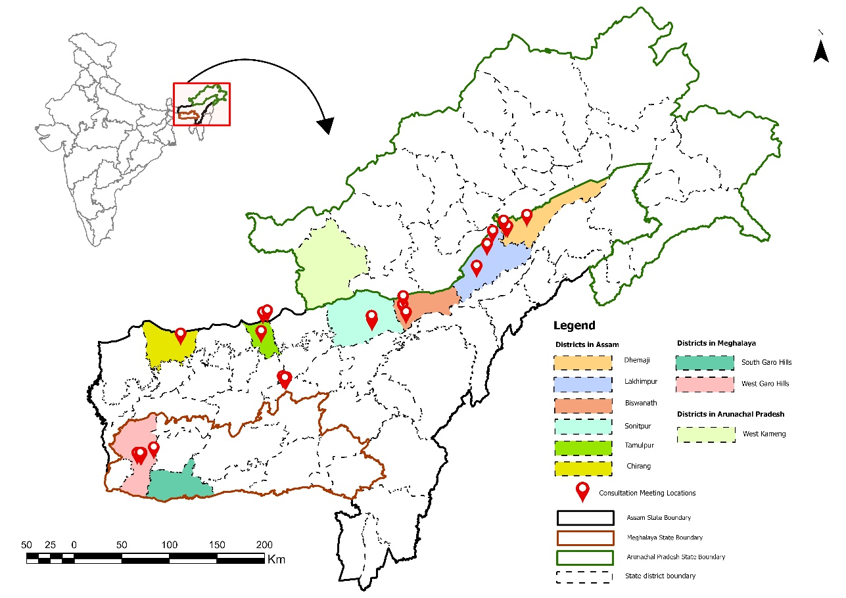
Priority Landscape
Northeast region is a priority landscape:
Ecological Significance
Biodiversity hotspots, critical habitats, threatened species, high-value conservation areas, ecosystem services
Vulnerability
Vulnerable to climate change, extant threats to ecosystem integrity and resilience, water security threats, remoteness
Dependence on natural resources
Livelihoods intertwined with natural resources, presence of indigenous communities, community-owned land resources, traditional governance systems
Conservation opportunity
Potential for community-led actions, multistakeholder partnerships and convergence, scaling-up
Priority Districts
Assam: Chirang, Tamulpur, Biswanath, Sonitpur, Lakhimpur and Dhemaji
Meghalaya: West Garo hills and South Garo hills
Arunachal Pradesh: West Kameng

Slide 4
Landscape Strategy Development Process
GEF-target Impact Metrics between 2026-2028
4000 ha of land restoration
30,000 ha of landscape under improved practices
1 MW renewable energy installation
GHG emissions/mitigated by 49, 275 MT of CO₂e
Direct project beneficiaries: 15,000 of whom 7500 are females
BASELINE ASSESMENT
• Desk Review
• Socio-economic surveys
• Multistakeholder Consultations (Community, Government Line Departments, Academic)
UNDERSTANDING THE LANDSCAPE
• Geography
• Biodiversity
• Socio-economic and Cultural profile
•Local Governance system
STAKEHOLDER MAPPING
• Identified Potential stakeholders
• Their interest and influence
SITUATION ANALYSIS
•Identified the priority issues
STRATEGIC RESPONSES
• Developed issue and target-based strategic responses
FUNDING FRAMEWORK
• Potential of convergence (Government Schemes), scaling-up
FOLLOW-UP
• Monitoring & Evaluation
• Knowledge Management • Theory of Change

Slide 5
Situation Analysis- Priority Issues and Strategic Responses
Climate Variability, and Limited Irrigation affecting Agriculture Productivity
Prevalent primarily in all districts
Decreasing productivity, affecting pastoralists (example: Brokpa community)
Strategic Response:
Promote community-managed irrigation system, including solar-powered irrigation systems
Revival of traditional Dong system
Integrated farming, self-reliant farming, revival of traditional climate-smart crops (Millet)
Community-based pasture management, restoration of degraded grasslands
Declining Agrobiodiversity, affecting food security
• Prevalent in all districts
• Impinges on food security, increase in monocropping and commercial horticulture, reduced ecosystem services
Strategic Response:
•Revival of indigenous landraces, traditional seed conservation systems, homestead gardens, crop diversification, intercropping
• Developing incentive mechanism, or nature-based enterprise
• Responsible tourism
• Value addition to local produces
• Improved market access

Slide 6
Situation Analysis- Priority Issues and Strategic Responses
Human-wildlife conflict, particularly HEC
Primarily prevalent in Assam and Meghalaya
Affects lives and livelihoods of people, and threatens species
Strategic Response:
Strengthen community-based conflict management through early warning systems, village response teams
Promotion of alternative livelihood, cultivation of non-palatable crops
Community Outreach
Advocacy for crop insurance under PMFBY, other insurance schemes
Restoration of degraded habitats, revival of corridors
Recurring Flood, Wetland Degradation, Livelihood Vulnerabilities
• Prevalent primarily in Assam’s Lakhimpur and Dhemaji districts
Strategic Response:
• Revival of traditional flood-resilient crops such as Bau-dhan (paddy)
• Sustainable fisheries
• Value addition
• Improved market access
• Promote nature-based solutions for flood management, restoration of riparian vegetation

Slide 7
Situation Analysis- Priority Issues and Strategic Responses
Limited Solid Waste Management and Circular Economy Opportunities
Primarily in Assam and Arunachal Pradesh
Strategic Response:
Operationalise existing waste management infrastructure under Swachh Bharat Mission
Decentralise waste collection, household level source segregation
Establishing community-manged Material Recovery Facility (MRF)
Limited Renewable Energy Access
Across all nine districts
Strategic Response:
Renewable energy-based livelihood intervention such as solar-powered rice mills, cold storage, post harvest technologies
Decentralised renewable energy solutions such as solar-powered community infrastructure, solar home lighting systems

Slide 8
Situation Analysis- Priority Issues and Strategic Responses
Rural Outmigration
• Across all nine districts
Strategic Response:
• Promotion of locally-tailored nature-based and climate-resilient livelihood opportunities
• Strengthen entrepreneurship skills of local youth, women and producers' groups
• Support value addition of local produces
Gender Inclusivity
• Across all nine districts
Strategic Response:
•Strengthen women's participation and leadership in community institutions, including Community Conserved Area (CCA) committees, SHGs, FPOs, village institutions and customary governance bodies.
• Integrate women's traditional ecological knowledge into biodiversity conservation, agro-biodiversity conservation, climate adaptation and natural resource management planning.
• Promote women-led livelihood enterprises lth agroecology, indigenous crops, NTFPs, food processing, weaving, sustainable tourism and other nature-based enterprises.

Slide 9
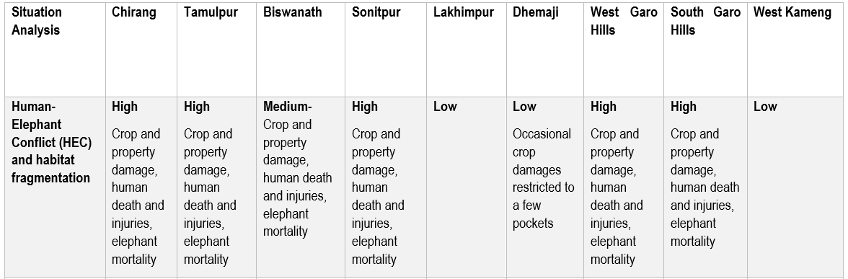
Situation Analysis- Priority Issues and Strategic Responses

Slide 10
Key Stakeholders
enterprise.
Government Line Departments
Interest: Sustainable Agriculture, Biodiversity Conservation, Waste Management
Influence: High
Potential Role: Technical Guidance, Convergence
Local Communities
Interest: Sustainable Agriculture, Renewable Energy, Access to natural resources, Livelihoods
Influence: Medium
Potential Role: Partners in implementation, social and economic benefits
Local Governance
Interest: Sustainable local development, natural resource management, community well-being, Biodiversity Conservation
Influence: High
Potential Role: Facilitate Community engagement, participatory planning, coordinate with Government agencies and local communities
Community-based Organisations
Interest: Strengthening climate resilience, Biodiversity Conservation, Capacity building, Sustainable Agriculture
Influence: Medium
Potential Role: Implement intervention to reverse environmental degradation, community empowerment, livelihood generation

Slide 11
Key Stakeholders
Women’s Groups
Interest: Supplementing Livelihood Opportunities, Equitable participation
Influence: Medium
Potential Role: Lead/Participate in gender responsive initiatives
Academia
Interest: Advancing research
Influence: Medium
Potential Role: Provide technical expertise
enterprise.
Private Sectors
Interest: Sustainable supply chains
Influence: Medium
Potential Role: Co-financing

Slide 12
Maximise Resources, Enabling Co-financing, Leveraging Existing Government Schemes and Program
Sustainable Agriculture
National Mission for Sustainable Agriculture - Integrated farming, sustainable land management
Assam Agribusiness and Rural Transformation (APART) – Climate-resilient agriculture, value addition,
Pradhan Mantri Krishi Sinchaayi Yojna (PMKSY)- Improves irrigation efficiency
ASRLM Integrated homestead farming- Supports farmer collectives, livelihoods, market linkages for rural communities
MBDA-MBMA- Natural resource management, rural livelihoods
NABARD- Sustainable agriculture/horticulture, homestead gardens
Chief Minister’s Farm Plus Scheme- Vermicompost support, planting materials, irrigation
Arunachal Pradesh Kiwi Mission- Promotes sustainable horticulture-based livelihoods

Slide 13
Maximise Resources, Enabling Co-financing, Leveraging Existing Government Schemes and Program
Biodiversity Conservation
Biodiversity Heritage site (in Sonitpur, Assam) -
Conservation of indigenous wild rice variety, associated traditional knowledge
GoI UNDP GEF Biodiversity Project – Strengthening BMCs, local biodiversity governance
Community Conserve Areas (CCAs)/Community Reserves- Rural livelihoods, habitat protection, species conservation
Waste management
Swachh Bharat Mission (Gramin)- Waste management in rural areas
Swachh Bharat Mission (Urban)- Scientific municipal solid waste management, recycling infrastructure
Community-based Waste Management initiatives through SHGs, and local institutions through MBMA and local governance- recycling enterprises
, sustainable tourism and other nature-based enterprises.
Renewable Energy
PM- KUSUM - Supports renewable energy solutions for agriculture
Geothermal Energy Development Initiative- Food drying, heating, sustains livelihoods
Community-based Waste Management initiatives through SHGs, and local institutions through MBDA and local governance- recycling enterprises
SELCO Foundation-Solar water pumps.

Slide 14
Strategy to Impact
Under SGP OP 8, when CBOs/local institutions are supported to
• conserve threatened ecosystems and species
• adopt sustainable and climate-resilient agriculture practices
• address climate-induced risks to pastoral livelihoods
• strengthen local governance, capacity
These will lead to
• Improved ecosystem health, ecological connectivity and ecosystem services
• Improved food and water security
• Enhanced climate resilience and livelihood opportunities
• increased community capacity
And Achieve
A resilient landscape where ecosystem integrity is restored, biodiversity is conserved, and communities benefit from improved social well-being, sustainable economies through strengthened local stewardship and sustainable livelihoods.

Slide 15
Acknowledgements
- Government Line Departments of Tamulpur, Biswanath, Sonitpur, Lakhimpur, Dhemaji, West Garo hills, PNRD, NABARD
- Local Communities across all the nine districts
- Representatives of Organisations- Aaranyak, Aprins, Canopy Collective, ERA-India, FMC, GreenHub, Lotus Progressive Centre, Midway Journey, Northeast Waste Collective, WWF-India
- Nandita Hazarika, and all other personnel who participated in KII
TERI NE Office
Avijan Saha- HEC photo
, indigenous crops, NTFPs, food processing, weaving, sustainable tourism and other nature-based enterprises.
Thank you

Slide 16
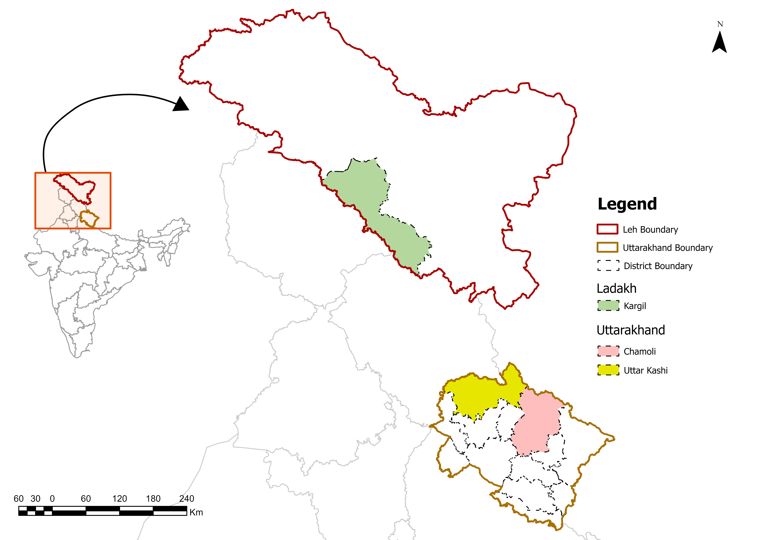
LANDSCAPE STRATEGY FOR BUILDING SOCIAL,ECONOMIC AND ECOLOGICAL RESILIENCE
IN
HIMALAYAN REGION (OP8)
UTTARAKHAND (Gangotri-Govindghat)
LADAKH (Kargil)

Slide 17



LADAKH (KARGIL)
Agriculture & Climate
Hydrology
Clean Energy
CHALLENGE
CHALLENGE
CHALLENGE
Water security issues, short cropping seasons, soil degradation, and changing rainfall pattern
Accelerated retreat of glaciers, unpredictable natural disasters (flash-floods, mud-slides)
Heavy dependence on firewood for space heating, diesel generators for lighting leading to high carbon emissions.
STRATEGY
STRATEGY
STRATEGY
Promote innovative water conservation measures, drip irrigation, cold-tolerant high-value crops, and solar greenhouse technology, native horticulture species.
Usage of check dams, and enhance community-led watershed management, afforestation.
Decentralised mechanisms for Rooftop Solar for space heating and lighting. Passive solar architecture.
Land & Urban Growth
Biodiversity Conservation
Waste & Pollution
CHALLENGE
CHALLENGE
CHALLENGE
Unplanned urban expansion, slope cultivation, and land degradation leading to severe soil erosion and biodiversity loss.
Habitat loss, species decline, feral dog wildlife conflict , HW conflict.
Solid waste, plastic accumulation, and tourism pressure .
STRATEGY
STRATEGY
STRATEGY
Smart urban planning, regenerative agriculture, long-term soil health monitoring, and slope reforestation.
Species Conservation of Flora and Fauna (incl. Lichens), restoration of degraded habitats, HW Conflict mitigation strategies (incl. solar fencing, non-lethal methods).
Implement integrated solid waste management and ecotourism initiatives, awareness and outreach.
Notes:
These are the major issues identified but there may be more

Slide 18


UTTARAKHAND (GANGOTRI-GOVINDGHAT)
Soil Erosion & Slopes
Drying Natural Springs
Agriculture & Wildlife
CHALLENGE
CHALLENGE
CHALLENGE
Frequent landslides, slope instability, and severe soil washouts during intense monsoon
Traditional mountain springs (Dharas and Naulas) drying up or becoming seasonal, causing acute water shortages.
Wild animal raids, agricultural land abandonment and population decline RET species.
STRATEGY
STRATEGY
STRATEGY
Bio-engineering slope stabilisation, wall terracing, and native tree afforestation.
Springshed rejuvenation hydro-geological recharge trenches, and community water sanctuary protection.
Protection of wildlife habitat and agricultural lands, cimmunity solar fencing, non-palatable crops, and agro-forestry initiatives.
Energy & Waste
Gender & Livelihoods
CHALLENGE
CHALLENGE
Unsustainable fuelwood harvest, forest degradation and indoor health risks; Tourism pressure particularly on pilgrim creating large scale plastic waste buildup,limited access to RE solutions in higher reaches.
Fuelwood and fodder collection burden on rural women; lack of localised youth employment opportunities, outmigration.
STRATEGY
STRATEGY
Empower Self-Help Groups (SHGs) in commercial value chains; promote ecotourism
Alternative fuels, improved cookstoves and RE access, waste management initiatives, awareness and outreach,

Slide 19
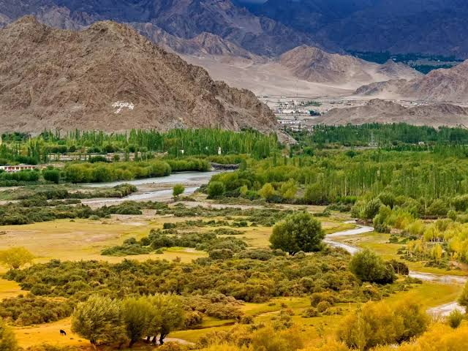

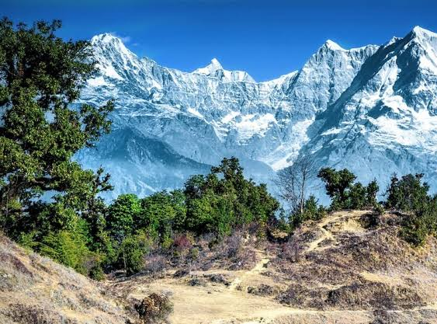
Thank you
Source: Time of India
Source: Niazul Hassan Khan; NatureinFocus
Source: Peakvisor.com
Sounika Karmakar and Madhabi Deuri

