Slide 1




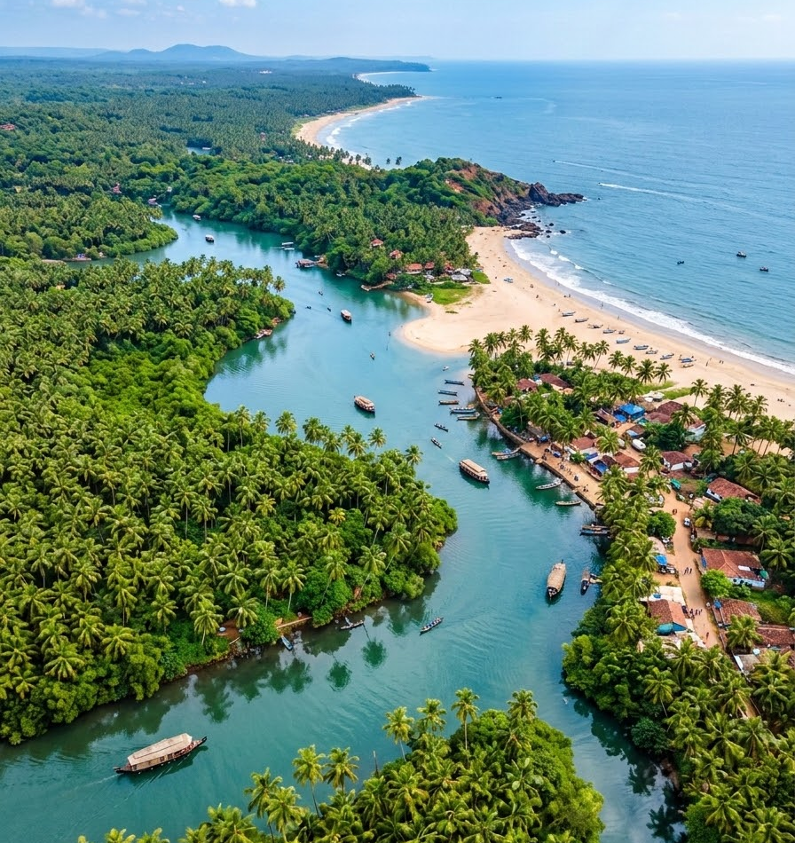


LANDSCAPE STRATEGY FOR BUILDING SOCIAL,
ECONOMIC AND ECOLOGICAL RESILIENCE IN INDIAN COASTAL REGION– ( OP-8 CYCLE)
VARDHAN PATANKAR & ASHA HADKAR
Western Ghats – Coastal Landscape
Goa and Karnataka
East Coast Landscape
Balasore and Bhadrak, Odisha; South 24 Parganas, West Bengal

Slide 2
The Landscape Strategy Overview
WEST COAST
Goa + Karnataka
EAST COAST
Balasore + Bhadrak + South 24 Parganas
Priority Landscape
- Reason for selection and its characteristics
- The approach and OP8 targets and impact metrics
Situation Analysis & Regional findings
What are the major threats?
What are the opportunities?
Who can support intervention/ stakeholders
How will interventions contribute to landscape-level change?
Project Portfolio and policy and program alignment
-What types of community-based projects can be supported?
- Convergence opportunities
Landscape Strategy (opportunities/ Priority areas/Intervention)
-What outcomes and impacts are being targeted?
Theory of Change
How will interventions contribute to landscape-level change?
A structured pathway from landscape understanding → strategic priorities → community action → measurable impact

Slide 3
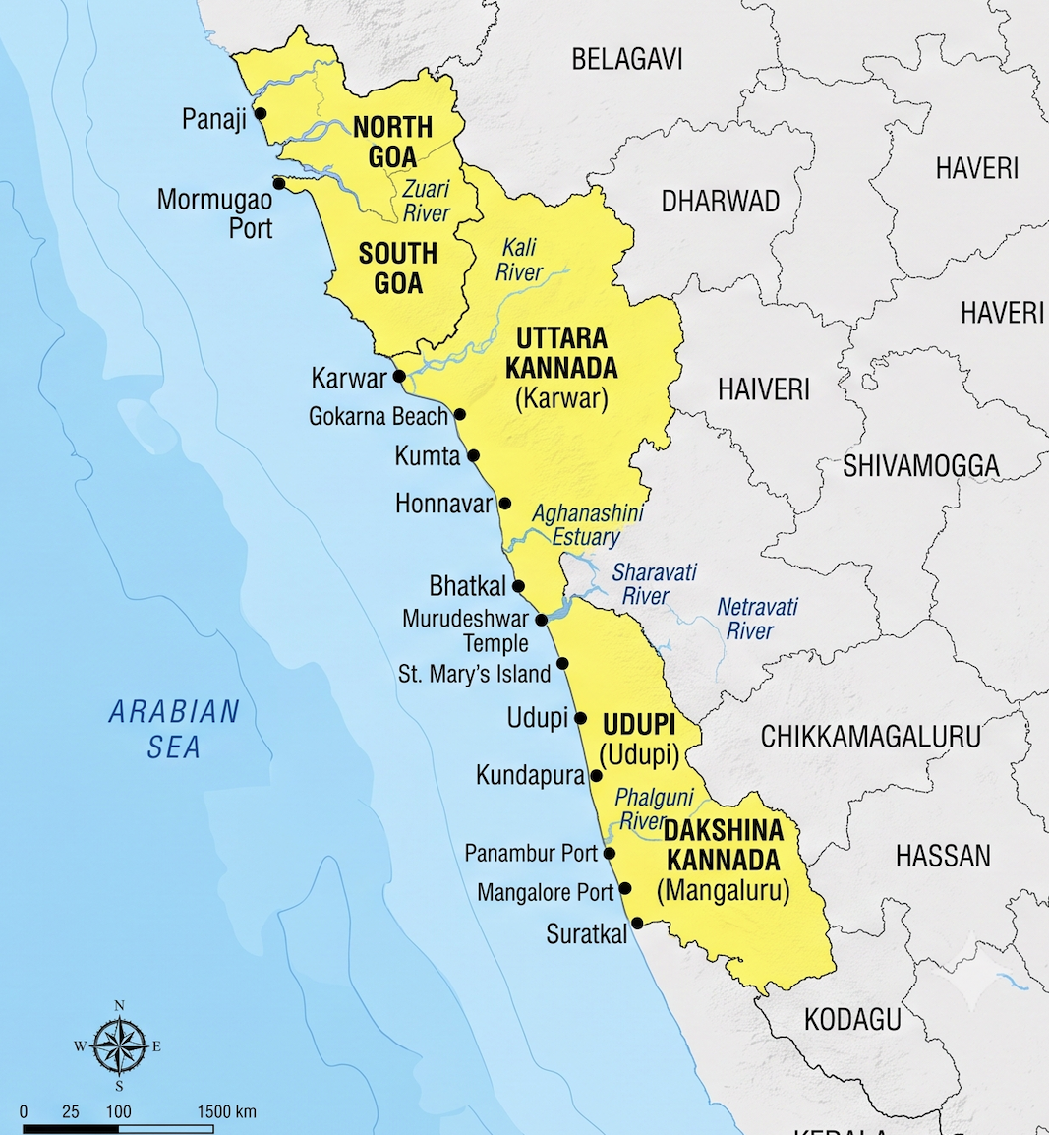
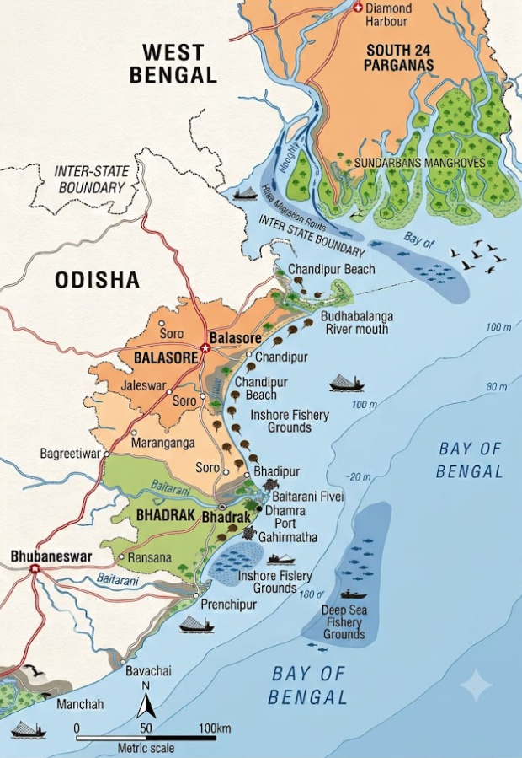
Selection Criteria
Ecological importance
High biodiversity and ecosystem value
Connectivity
Forests → Rivers → Wetlands → Estuaries → Coastal & Marine Ecosystems
Livelihood dependence
Agriculture | Fisheries | Aquaculture | Forest-based livelihoods
Ecosystem Services
Blue carbon, fisheries, blue economy
Conservation opportunity
Potential for community-led action, convergence and scaling
EAST COASTAL LANDSCAPE
Balasore + Bhadrak, Odisha
South 24 Parganas, West Bengal
WESTERN GHATS–COASTAL LANDSCAPE
Goa + Coastal Karnataka

Slide 4
The approach of conducting study and GEF OP8 target Impact metrics
GEF-8 Target Impact Metrics
Key environmental and community targets of the operational phase
Desktop review
Stakeholder consultation
Focus group survey guided by SEPLS
Key informant surveys
Informal interviews and discussion with
members of the State Biodiversity Board
Discussion with bureaucrats and government officers
5,000 ha
Degraded Ecosystems Restored
25,000 MT
CO₂e GHG Emissions Mitigated
10,000 -15,000 ha
Area of Landscapes under Improved Practices
1 MW
Decentralized Renewable Energy
7,000+
Direct Beneficiaries
(40% Women)

Slide 5
SITUATION ANALYSIS
What problems is the proposed programme trying to solve?
Ecological Pressures
Habitat fragmentation
Wetland degradation
River & catchment decay
Mangrove loss
Coastal degradation
Resource Pressures
Declining fisheries
Unsustainable resource use
Resource extraction
Intensive agriculture
Climate & Env. Risks
Flooding & erosion
Cyclones & storms
Changing rainfall
Pollution
Saline intrusion
Livelihood Vulnerability
Declining productivity
Limited diversification
Climate-sensitive jobs
Unequal opportunities

Slide 6
REGIONAL ASSESSMENT: GOA AND KARNATAKA
West Coast: threats, opportunities and landscape priorities
Key Ecological Concerns
Degradation of river catchments
Wetland and Khazan degradation
Estuarine and mangrove pressures
Habitat fragmentation
Coastal and marine pollution
Degradation of lateritic and other critical habitats
Key Livelihood Concerns
Declining fisheries
Pressure on natural resources
Changing agricultural systems
Livelihood vulnerability
Coastal development pressures
Opportunities
Community-led restoration
Sustainable fisheries and shellfish systems
Biodiversity-compatible livelihoods
Strengthened local institutions

Slide 7
REGIONAL ASSESSMENT: EAST COAST
Balasore, Bhadrak and South 24 Parganas
Key Ecological Concerns
Mangrove and wetland degradation
Altered hydrology
Coastal erosion
Pollution
Habitat fragmentation
Climate-related risks
Key Livelihood Concerns
Fisheries and aquaculture vulnerability
Saline intrusion
Cyclone exposure
Dependence on natural resources
Limited livelihood diversification
Opportunities
Mangrove restoration
Sustainable fisheries and aquaculture
Blue carbon
Climate-resilient livelihoods
Community-based conservation

Slide 8
LANDSCAPE PRIORITIES AND STRATEGIC INTERVENTIONS
Key opportunities and priority interventions identified through stakeholder consultations and community engagement
WESTERN GHATS–COASTAL LANDSCAPE
Goa + Coastal Karnataka
Potential opportunities
Ridge-to-reef conservation
Restoration of wetlands, mangroves & estuaries
Sustainable fisheries & shellfish livelihoods
Biodiversity-based enterprises
Climate-resilient livelihoods
Priority Areas
Declining fisheries
Western Ghats–coastal connectivity
Kali, Sharavathi, Aghanashini & Gangavali river systems
Mandovi–Zuari estuaries & Khazan systems
Wetlands, mangroves & coastal habitats
Interventions
• River, wetland & mangrove restoration
• Sustainable fisheries & Fish FPOs
• Shellfish-based enterprises
• Climate-resilient agriculture & agroforestry
• Nature-based & women/youth enterprises
• Community conservation & BMCs
Potential opportunities
Ridge-to-reef conservation
Restoration of wetlands, mangroves & estuaries
Sustainable fisheries & shellfish livelihoods
Biodiversity-based enterprises
Climate-resilient livelihoods
Priority Areas
Declining fisheries
Pressure on natural resources
Changing agricultural systems
Livelihood vulnerability
Coastal development pressures
Intervestions
Community-led restoration
Sustainable fisheries and shellfish systems
Biodiversity-compatible livelihoods
Strengthened local institutions
EAST COASTAL LANDSCAPE
Balasore + Bhadrak, Odisha
South 24 Parganas, West Bengal

Slide 9
CONVERGENCE/POLICY AND PROGRAMME ALIGNMENT
Connecting the landscape strategy to existing initiatives
Existing Initiatives
GEF SGP and UNDP
GEF SGP Operational Phase 8
National programmes
State-level initiatives
Community and civil society initiatives
The Landscape Strategy Adds:
Spatial Integration
Connecting interventions across ecosystems and communities
Strategic Integration
Linking local action to landscape-level outcomes
Programmatic Integration
Creating opportunities for convergence and co-financing

Slide 10
STAKEHOLDERS AND LANDSCAPE GOVERNANCE
Who needs to be part of the strategy?
Community Institutions
Gram Panchayats
Biodiversity Management Committees
Self-Help Groups
Fish FPOs
Producer Organisations
Government & Public
Forest Department
Fisheries Department
Agriculture Department
Rural Development
Local Governments
Knowledge Partners
NGOs
Civil society orgs
Universities
Research institutions
Technical organisations
Private Sector & Markets
Value-chain actors
Processors
Market institutions
Responsible businesses
KEY PRINCIPLE: Landscape-level change requires coordination across institutions and scales.

Slide 11
THEORY OF CHANGE
How will interventions contribute to landscape-level change?
IF
Communities and local institutions are supported to:
Conserve and restore forests, rivers, wetlands, estuaries, mangroves and coastal ecosystems
Adopt sustainable, climate-resilient agriculture, fisheries and production systems
Develop diversified, biodiversity-compatible livelihoods
Strengthen local governance, gender integration, local governance, knowledge and monitoring
THEN
Ecosystems and ecological connectivity improve
Biodiversity and threatened species are better conserved
Natural resources are managed sustainably
Livelihoods become more resilient and diversified
Local institutions strengthen their capacity for natural resource management
CONTRIBUTING TO
A healthy, connected and climate-resilient landscape
10k–15k ha
Landscapes under Improved Practices
5,000 ha
Ecosystems Restored
5,000 to 10000 MT
CO₂e Greenhouse Gas Mitigated
1 MW
Renewable Energy Supported
7,000+
Beneficiaries (30 to 40% Women)

Slide 12
Thank You!
Vardhan Patankar & Asha Hadkar
vardhanpatankar@gmail.com
ashag@teri.res.in

