Slide 1




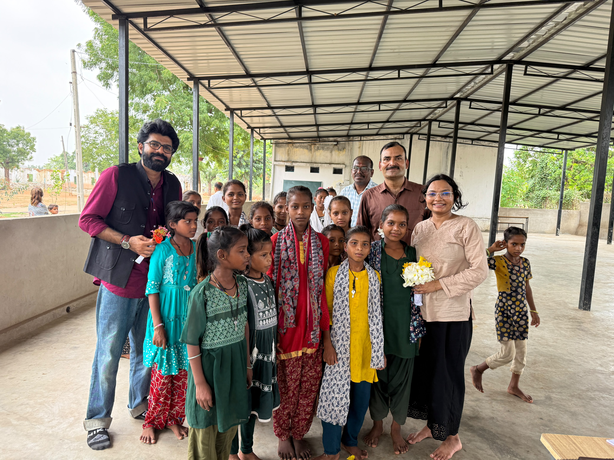
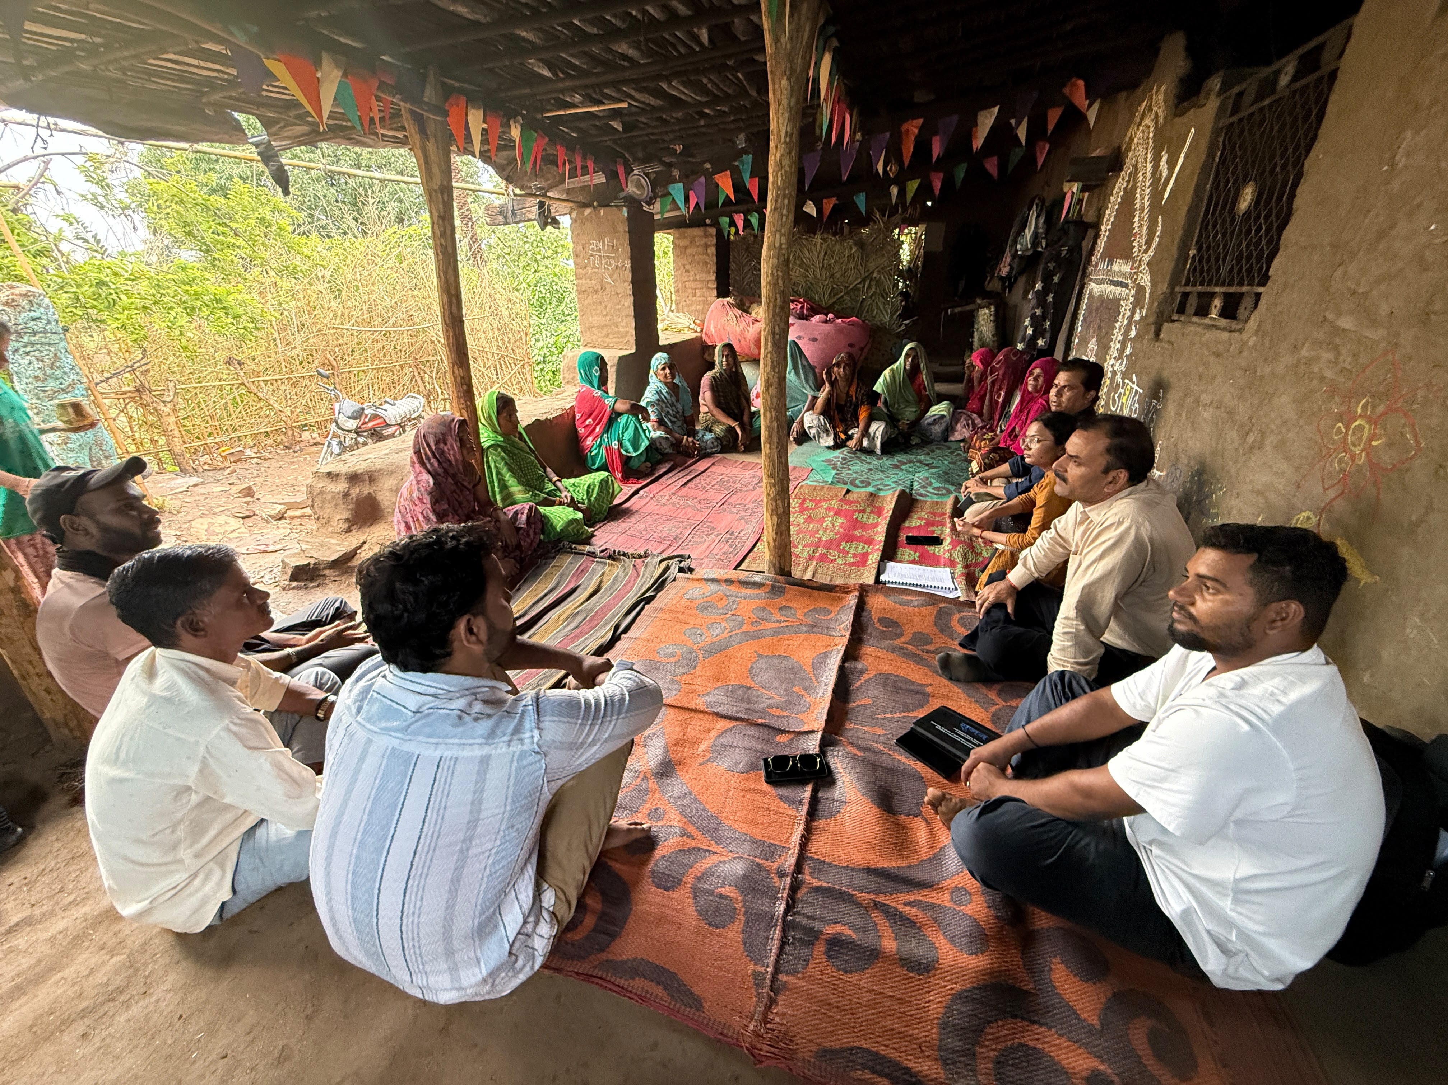
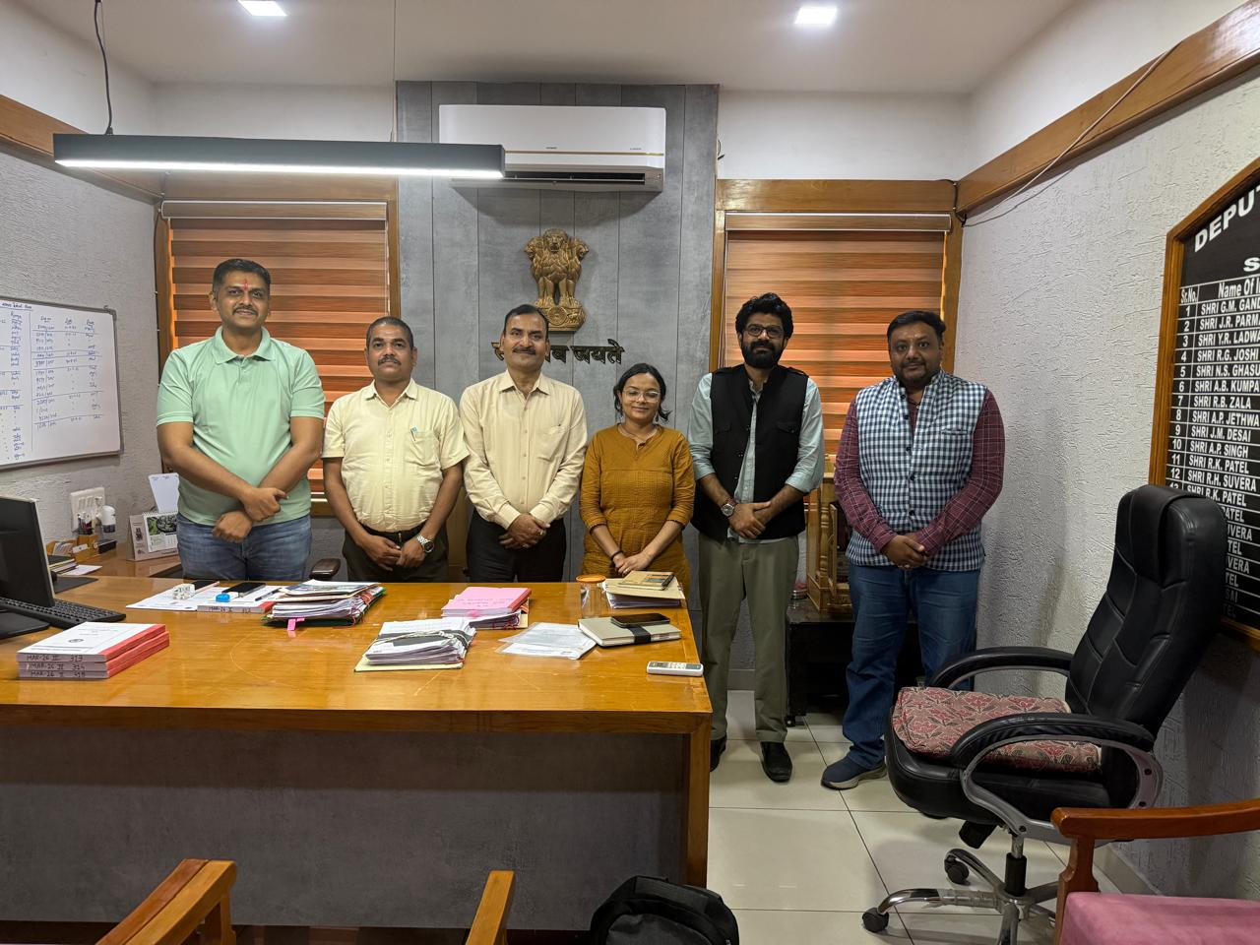

LANDSCAPE STRATEGY FOR BUILDING SOCIAL, ECONOMIC AND ECOLOGICAL
RESILIENCE IN ARAVALLI LANDSCAPE – OPERATIONAL PHASE 8

Slide 2
Presentation Overview & Contents
Landscape strategy for building social, economic and ecological resilience in the Aravalli Landscape (GEF-SGP OP-8 Cycle)
Section | What This Presentation Covers
1. Priority Landscape Selection and Rationale | Why the Aravalli landscape was chosen for the OP-8 cycle
2. Introduction to the Aravalli Landscape | Introduction to the Aravalli Landscape and Districts
3. Approach and Methodology for District Prioritization | Details of the approach adopted for Prioritization
4. Key parameters and priority district | 16 Key Scoring Parameters and Priority Ranking of Aravalli Districts
5. Situation Analysis | Identification of Key Threats and Investment Opportunities in the Aravalli Landscape
6. Priority Intervention Areas | Five thematic strategy areas : ecological restoration, water security, agriculture/livelihoods, mining land restoration, and community institutions
7. Convergence Opportunities & Programmatic Alignment | Potential National, Rajasthan, and Gujarat Government Schemes Mapped to SGP Thematic Areas for Convergence
8. Important Stakeholders for Landscape Governance | Key Stakeholders for Effective Landscape Governance and Implementation

Slide 3
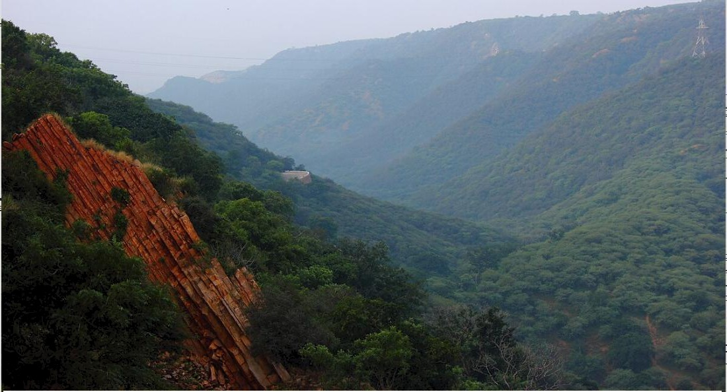
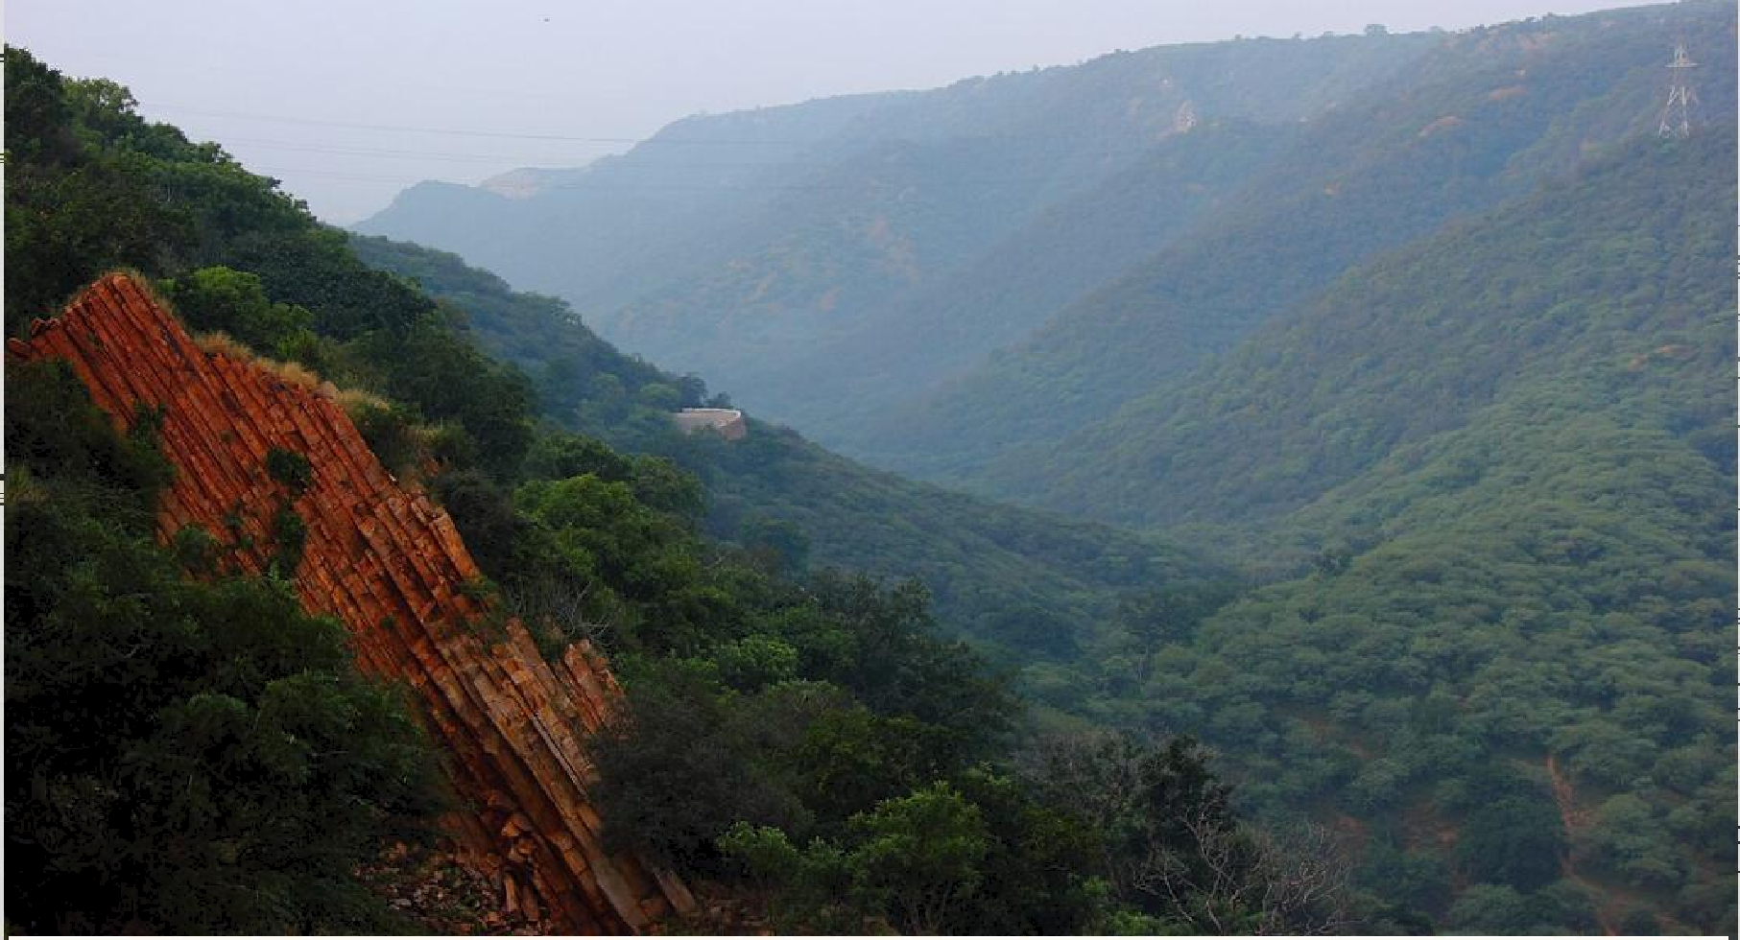
Priority Landscape Selection and Rationale
Acts as a natural barrier against the expansion of the Thar Desert, reducing desertification.
Protects key watersheds and river systems, improving water security across the region.
Enhances groundwater recharge to sustain water availability in drought-prone and water-stressed areas.
Conserves rich biodiversity by safeguarding critical habitats and wildlife corridors.
Builds climate resilience by reducing heat stress and dust storms while increasing carbon sequestration.
Supports sustainable livelihoods through improved agriculture, livestock production, and ecosystem services.
Preserves cultural and natural heritage, including sacred groves and historically significant landscapes.
Promotes long-term ecological sustainability for local communities and future generations.

Slide 4
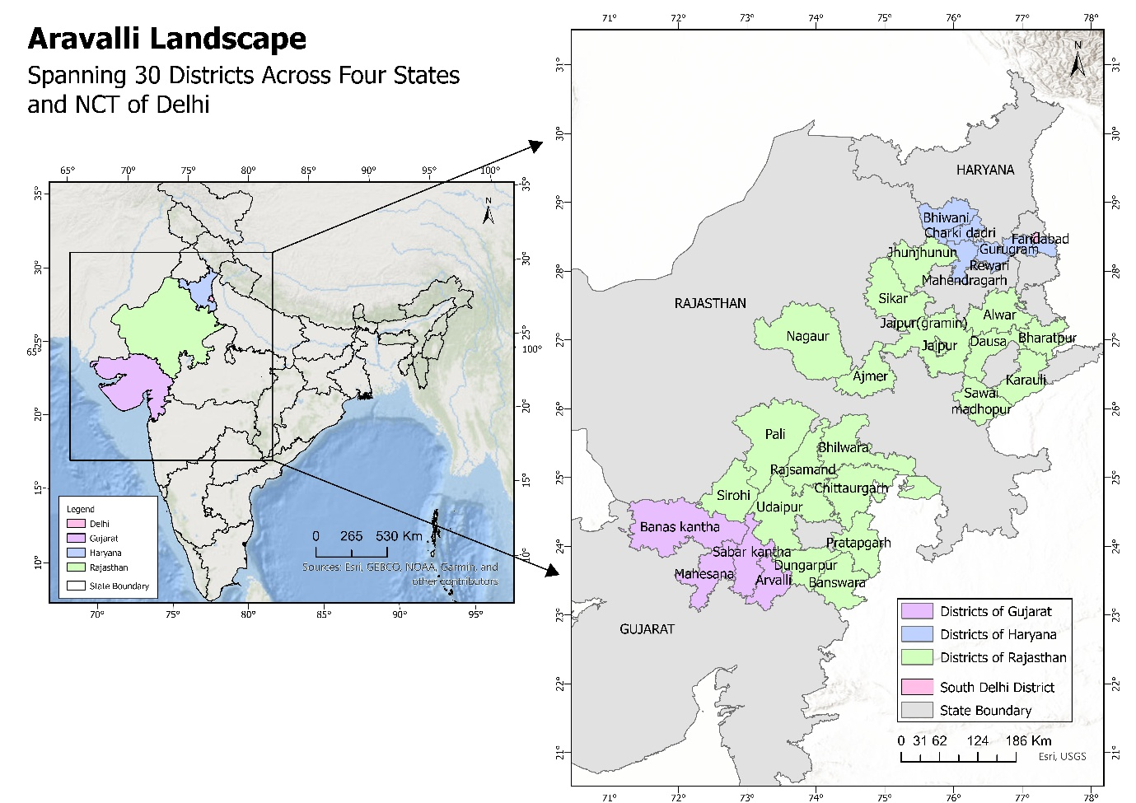
Introduction to the Aravalli Landscape
Aravalli Landscape Coverage -
Rajasthan (19 districts): Ajmer, Alwar, Banswara, Bharatpur, Bhilwara, Chittorgarh, Dausa, Dungarpur, Jaipur, Jhunjhunu, Karauli, Nagaur, Pali, Pratapgarh, Rajsamand, Sawai Madhopur, Sikar, Sirohi, and Udaipur.
Gujarat (4 districts): Banaskantha, Sabarkantha, Mehsana, and Aravalli.
Haryana (6 districts): Bhiwani, Charkhi Dadri, Faridabad, Gurugram, Mahendragarh, and Rewari.
Delhi (NCT): South Delhi district.
Note: The number of districts included in the Aravalli landscape assessment is based on the landscape coverage defined in the Detailed Action Plan for Aravalli Landscape Restoration (Aravalli Green Wall Initiative) published by the Ministry of Environment, Forest and Climate Change (MoEFCC).

Slide 5
Approach and Methodology for District Prioritization – Methodology Steps
Step | Stage | Description
1 | Multi-Indicator Assessment | All Aravalli districts assessed using 16 key indicators spanning ecological, environmental, socio-economic, and restoration-related aspects.
2 | Composite Scoring & Ranking | A composite score was developed for each district and ranked by severity of degradation, vulnerability, and restoration potential, sorting districts into six priority categories.
Score Threshold | Pathway
Above 30 | Taken up for restoration investments, conservation actions, and targeted field interventions in partnership with CSOs.
30 or below | Supported through awareness generation, capacity building, and training programmes to promote sustainable land management and prevent further land degradation.

Slide 6
Parameters used for District
Prioritized Districts based on the Scoring
Sr. No. | Parameter | Sr. No. | Parameter
1 | Total Degraded Area (TDA) (across Forest , scrub ,agriculture land) | 9 | Anthropogenic Pressure (Overall population & Built-up Growth by 2030)
2 | Land Productivity Dynamics (LPD) Decline (Total Decline/Early Decline (Ha) | 10 | Tribal Population and Dominance
3 | Stage of Groundwater Extraction (%) | 11 | Rate of In Migration
4 | Forest Canopy Loss (FVC Change) | 12 | Rate of Out Migration
5 | Forest Fire Vulnerability | 13 | Biodiversity richness
6 | Mining-Induced Physical Destruction | 14 | Watershed/water recharge area functions/ Stress on Aquifer
7 | Human Health Vulnerability due to Mining (Silicosis Burden) | 15 | Aspirational District/Block
8 | Presence of Wildlife Corridors | 16` | Cultural and Community Conservation Heritage
Score Range | Name of the District | State | Score
51- 60 (Very High Priority) | Udaipur | Rajasthan | 57
 | Alwar | Rajasthan | 51
41-50 (High Priority) | Banaskata | Gujarat | 48
 | Sirohi | Rajasthan | 42
 | Dungarpur | Rajasthan | 41
31-40 (Moderate Priority) | Jaipur | Rajasthan | 39
 | Ajmer | Rajasthan | 39
 | Pali | Rajasthan | 37
 | Rajsamand | Rajasthan | 36
 | Pratapgargh | Rajasthan | 35
 | Banswara | Rajasthan | 35
 | Sabarkantha | Gujarat | 33
Note: Most indicator-wise data used for district scoring and prioritization was compiled from two key reference publications: the Report on Scoping Study of the Aravalli Hills and the Detailed Action Plan for Restoration of Aravalli (Aravalli Green Wall Initiative) published by the Ministry of Environment, Forest and Climate Change (MoEFCC).

Slide 7
2
3
4
Stakeholder Consultations and Ground Validation
1) Ground Validation
2) Representative Districts
3) 16 Stakeholders, 7 Institutions
4) Community FGDs
District Admin (Collector, ADM, RAC)
Forest Dept (DCF, ACF)
Horticulture Dept
NABARD
NRLM / Rajeevika
Tribal Dev. Dept (TDO)
Krishi Vigyan Kendra (KVK)
Conducted Focus Group Discussions (FGDs) in five representative villages using the SEPLS framework (GEF COMDEKS methodology) to validate spatial assessment findings, assess socio-ecological production landscapes, and identify community priorities and restoration challenges.
Field consultations followed district prioritisation to validate ground realities and identify locally relevant restoration priorities.
Gujarat: Banaskantha, Sabarkantha
Rajasthan: Udaipur (South Aravalli), Alwar (North Aravalli)
District Administration (Collector, ADM, RDC)
Forest Dept (DCF, ACF)
Horticulture Dept
NABARD
NRLM / Rajeevika
Tribal Dev. Dept (TDO)
Krishi Vigyan Kendra (KVK)
FGDs conducted in:
Berla, Alwar (Rajasthan) , Sarli, Udaipur (Rajasthan) , Bekriya, Udaipur (Rajasthan) , Ganava, Sabarkantha (Gujarat) Bedapani, Gujarat

Slide 8






Situation Analysis
Forest & Land Degradation
Water Scarcity
Biodiversity Loss
Invasive species, erosion, and shrinking forest cover are reducing ecosystem resilience.
Poor recharge, degraded water bodies, and rainfed farming heighten climate vulnerability.
Reduced ecological connectivity threatens native and RET species habitats.
Livelihoods & NTFP
Weak Institutions
Mining & Industrial Pressure
Weak NTFP value chains and a shift from traditional to commercial agriculture.
Inactive JFMCs/BMCs and scarce nurseries constrain restoration capacity.
Land degradation, pollution, and habitat disturbance are rising, especially near Alwar.

Slide 9
Priority Intervention Areas
Ecological Restoration & Biodiversity Conservation
Restore degraded forests, common lands & mining-affected areas; manage invasive species; conserve RET species and ecological corridors.
Water Security & Watershed Management
Revive traditional water bodies; build check dams, percolation tanks & recharge structures; promote efficient irrigation and watershed management.
Sustainable Agriculture, Agroforestry & Livelihoods
Promote climate-resilient farming, agroforestry & NTFP value chains; support decentralized nurseries, producer groups and enterprises.
Restoration of Mining & Industrially Degraded Land (Rajasthan)
Restore mining-affected land through native plantation and slope stabilization; promote green belts and industry-led environmental stewardship.
Strengthening Community Institutions & Governance
Build capacity of JFMCs/BMCs; prepare village conservation plans and include them in GPDP ; expand participation of women and youth; strengthen government convergence.

Slide 10
Convergence Opportunities and Programmatic Alignment
Scheme | Focus | Link to SGP Theme
CAMPA | Compensatory afforestation funding | Ecological restoration
WDC-PMKSY 2.0 | Watershed-based land treatment | Water security; land restoration
G RAM G | Labour convergence for water & plantation works | Water security; livelihoods
DAY-NRLM | SHG-based livelihoods | Livelihoods; community institutions
Sub-Mission on Agroforestry | Agroforestry on bunds/wastelands | Sustainable agriculture
PM-KUSUM / PM Surya Ghar | Solar pumps, decentralized solar | Renewable energy
MJSA 2.0 | Water conservation & recharge | Water security; land restoration
DMF Funds | Mining area reclamation | Land restoration (mining)
Praja Vikendrit Nursery | To raise seedlings in school nursery | Ecological restoration through planation

Slide 11
Important Stakeholders for Effective Landscape Governance
Stakeholder | Role in Landscape Governance
MoEF&CC | Nodal ministry for forests, environment; oversees SGP and Aravalli Green Wall Project
Ministry of Tribal Affairs | Drives convergence across tribal blocks in project districts
State Forest Departments (Guj/Raj) | Forest management, CAMPA afforestation, Joint Forest Management
Watershed Dev. & Soil Conservation Dept (Raj) | watershed treatment works
Water Resources Department (Guj) | Implements Sujalam Sufalam Jal Abhiyan
Agriculture & Horticulture Departments | Agroforestry promotion, Krushi Mahotsav, farmer extension
Tribal Development Departments | Vanbandhu Kalyan Yojana; tribal livelihood & service delivery
Mines Department | Mining regulation, DMF-funded reclamation of mined areas
District Collectors & Administration | Chair District Level Committees ( DMF); local approvals
Gram Panchayats | Local self-governance, village-level planning & fund utilisation
NABARD | Financing for watershed and tribal development projects
Krishi Vigyan Kendras (KVKs) | Agricultural extension, training & technology transfer
RSRLM / GLPC (State Rural Livelihood Missions) | SHG mobilisation, federation-building, livelihoods
SHGs & Federations | Savings, credit and livelihood diversification at village level
JFM Committees / Pani Samitis / BMCs | Community-level forest, water and biodiversity management
NGOs / CBOs / CSOs/On going Projects | Partner with ongoing restoration initiatives and CSR programmes, such as RECAP4NDC and the Lupin Foundation, to support on-ground implementation of SGP interventions.

Slide 12
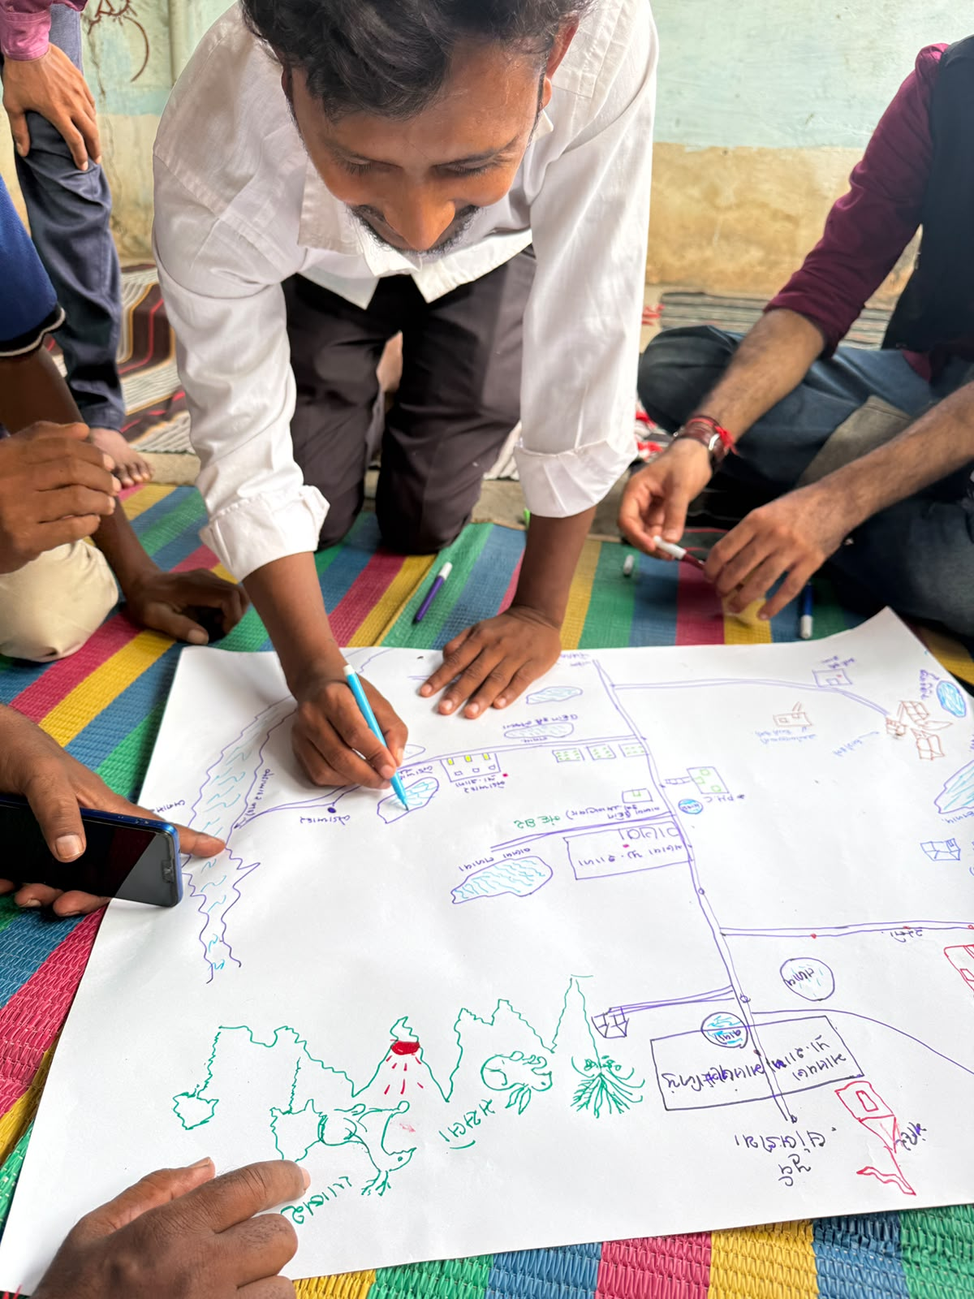
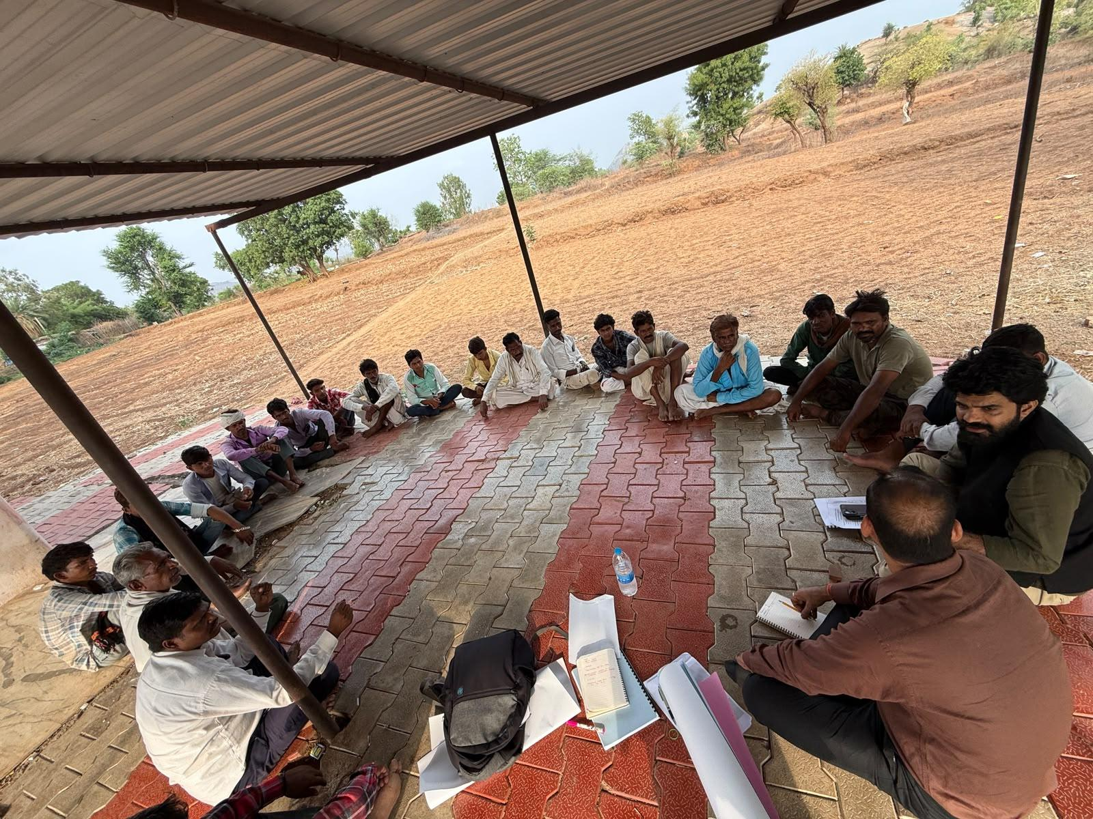
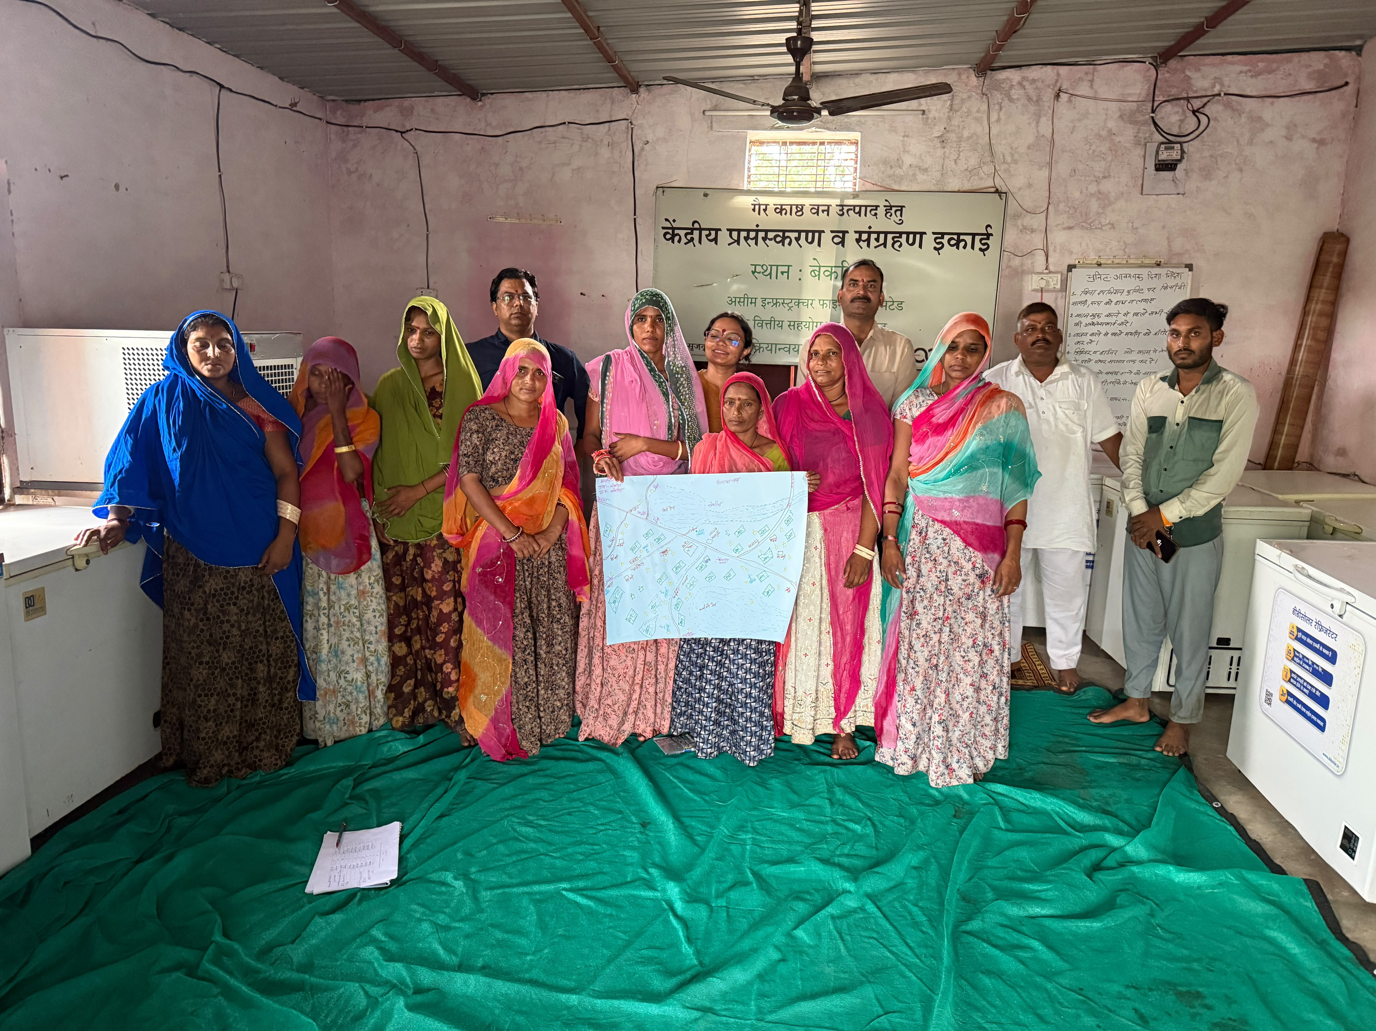
Thank You

